Slide 1

Towards a Practically Useful Text Simplification System
Reno Kriz
Advisors: Chris Callison-Burch, Marianna Apidianaki
Thesis Committee: Mitch Marchus (chair), Dan Roth, Lyle Ungar,
Eleni Miltsakaki (external)
Notes:
Hi everyone, I’m Reno, and I’ve been co-advised by Chris Callison-Burch and Marianna Apidianaki. Today I’m presenting an overview of my thesis, which is titled towards a practically useful text simplification system.

Slide 2
Goal of Text Simplification
Notes:
I want to start with the following rhetorical question: what should be the ultimate goal of a system claiming to address the problem of text simplification?

Slide 3
Goal of Text Simplification
Help someone more easily learn about a topic
Notes:
I think that the goal should be to make it easier for a person to learn about a topic.

Slide 4
Goal of Text Simplification
Help someone more easily learn about a topic
Amount of help needed varies
Prior background knowledge
Ability to learn new concepts
Notes:
Now, the amount of help a person requires can vary widely. If someone has a lot of experience with a given topic, it’s likely that little help is necessary, while more help is required if someone is attempting to learn about a relatively new field. In addition, native speaking adults have a large general understanding of language and concepts to rely upon, and are thus likely relatively quick learners. However, other groups such as younger children, people with disabilities, and second language learners likely do not have this same understanding.

Slide 5
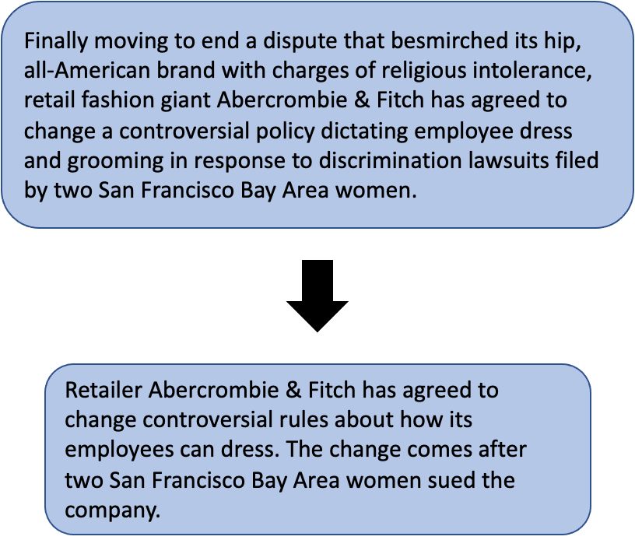
Current Formulation
Notes:
So, how does this goal match up with the simplification tasks in the NLP community? Well, text simplification in NLP generally refers to transforming a complex text into one with the same meaning, but that can be more easily understood.

Slide 6
Current Formulation
Notes:
So this formulation generally makes sense, as this would make texts easier for those that need it. In addition, this formulation also has natural benefits for downstream NLP tasks, such as syntactic parsing, semantic role labeling, and machine translation. This is because long and complex sentences are generally hard for NLP models to handle, and breaking these down into shorter, simpler sentences using common language can allow for improved performance.

Slide 7
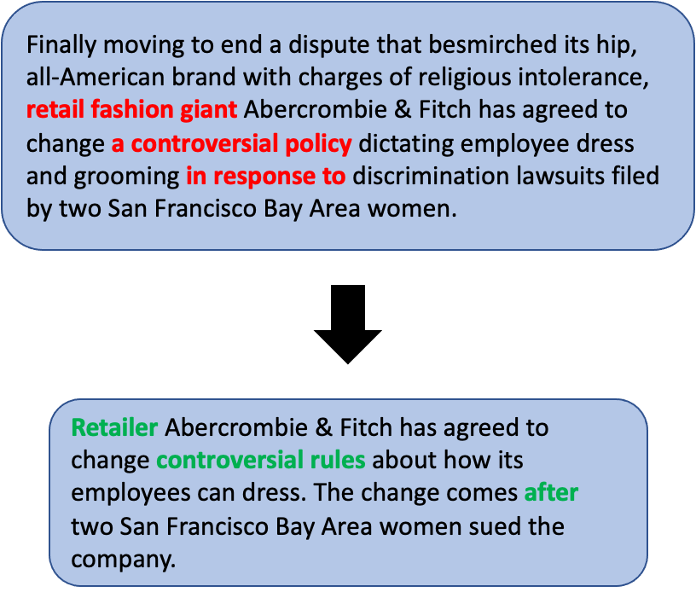
Current Formulation
Substitution
Notes:
Within this formulation, the process of simplifying a text can be broken down into four aspects. The first is lexical and phrasal substitution, which is the process of replacing complex words and phrases with simpler ones that have the same meaning in the context of the text. In this example, we can see that we change “policy” to “rules”, and also “in response to” to “after”

Slide 8
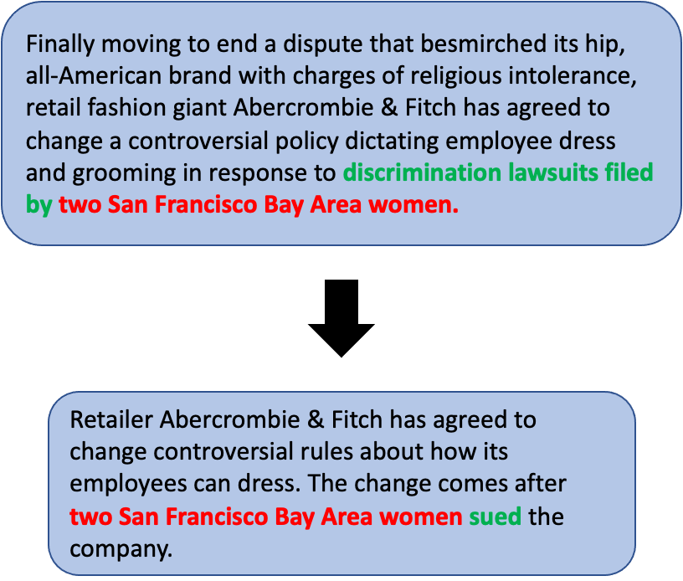
Current Formulation
Substitution
Reordering
Notes:
The second is word reordering, which is the process of re-organizing the contents of a sentence in a way that makes it easier to understand. In this example, we change the order in the last part of the text so that it goes from using passive to active voice

Slide 9
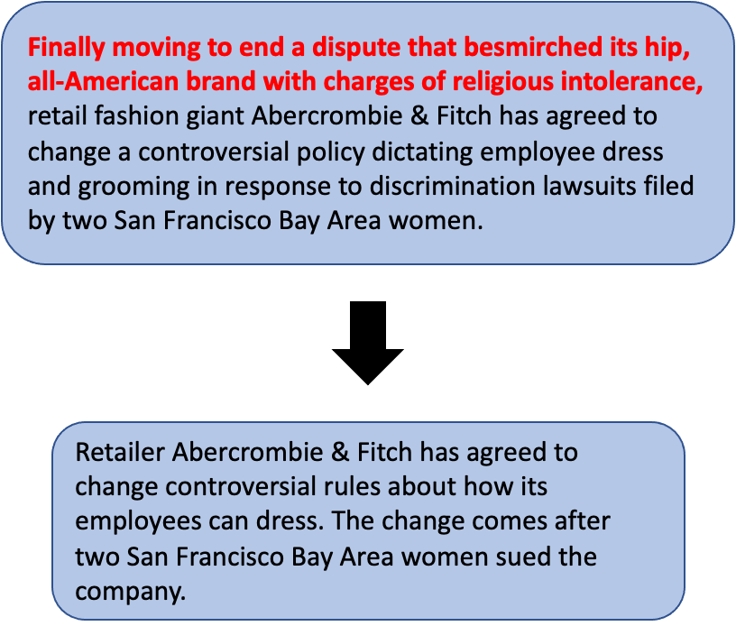
Current Formulation
Substitution
Reordering
Deletion
Notes:
The third is deletion, where we remove parts of the text that are not crucial to preserving the main meaning of the original text. This aspect is also desirable in summarization, which is why the two fields are considered somewhat related.

Slide 10
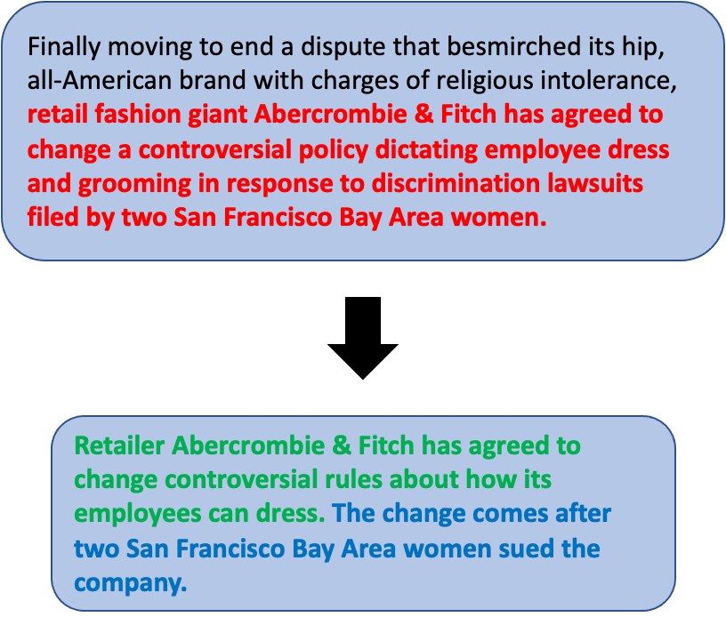
Current Formulation
Substitution
Reordering
Deletion
Sentence Splitting
Notes:
And finally we have sentence splitting, where we break up long and complex sentences into two or more shorter sentences. This is a reasonable way to think about text simplification, and there are many extremely interesting problems within this space. Thus, much of the work so far in my PhD, and the simplification field in general, has focused on this framing of the problem.

Slide 11
Limitations of Current Formulation
Notes:
However, there are some key limitations to this approach, which make it somewhat challenging to create a simplification system that is useful in a practical setting.

Slide 12
Limitations of Current Formulation
“Complexity” is not a binary notion
What is complex often varies by individual
4
Bear-human conflicts turn serious in Central Florida community.
3
Black bears are moving in on Central Florida neighborhoods.
2
Encounters with black bears on the rise in Central Florida.
1
Central Florida has a big problem with bears.
0
Bears are a problem in Central Florida.
Notes:
The first problem is that this formulation generally assumes that complexity is a binary concept, but in reality, this is not the case. We can simplify texts in a variety of ways, and what is considered complex by some may be considered simple by others.

Slide 13
Limitations of Current Formulation
“Complexity” is not a binary notion
What is complex often varies by individual
Many expressions cannot be satisfactorily transformed into simpler language
E.g. algorithm, machine learning
Notes:
In addition, many phrases or expressions in a text cannot simply be transformed in simpler language while still preserving the original meaning. For this, we can think of standard machine learning concepts such as algorithm and machine learning.

Slide 14
Thesis Statement
In this thesis, we claim that the textual complexity at any level is not a static value, but instead is influenced both by the surrounding text and especially the knowledge of a particular reader. Thus, in order to create a practically useful simplification system, it is critical to be able to adjust the outputs of our models depending on the situation.
Notes:
So, based on this introduction, in this thesis we claim that the textual complexity at any level is not a static value, but instead is influenced both by the surrounding text and especially the knowledge of a particular reader. Thus, in order to create a practically useful simplification system, it is critical to be able to adjust the outputs of our models depending on the situation.

Slide 15
Thesis Outline
Notes:
I have broken up my thesis into four main sections, of which I’m going to discuss three today.

Slide 16
Thesis Outline
Simplification using Paraphrases and Context-based Lexical Substitution
Notes:
The first considers the task of lexical simplification. In particular, I focus on the role context plays in both identifying complex words, and when making meaning-preserving substitutions.

Slide 17
Thesis Outline
Simplification using Paraphrases and Context-based Lexical Substitution
Modeling and Evaluation of Sentence Simplification
Notes:
Second, I consider the task of sentence-level simplification. This work first involves extending popular encoder/decoder generation models to encourage them to make more simplification-specific transformations, and second involves leveraging large-scale pre-trained language models for evaluating the quality of sentence simplification systems.

Slide 18
Thesis Outline
Simplification using Paraphrases and Context-based Lexical Substitution
Modeling and Evaluation of Sentence Simplification
Recasting Text Simplification as a Retrieval Task
Notes:
Finally, due to the limitations I’ve briefly discussed in the current formulation of text simplification, I will propose a retrieval-based reformulation. Given a text, I propose to identify concepts that are critical for understanding that text. From there, for each concept, I propose to find relevant documents and re-rank them based on their appropriateness for a user.

Slide 19
Thesis Outline
Simplification using Paraphrases and Context-based Lexical Substitution
Modeling and Evaluation of Sentence Simplification
Recasting Text Simplification as a Retrieval Task
Notes:
I will start with lexical simplification.

Slide 20
Lexical Simplification
The task of replacing difficult words in a text with simpler ones
Notes:
Lexical simplification is the task of replacing difficult words in a text with words that are easier to understand.

Slide 21
Lexical Simplification
The task of replacing difficult words in a text with simpler ones
Involves two main processes
Identifying complex words
The museum's director said there has never been such an exhibition of Dutch portraits.
Notes:
This involves two main sub-processes. The first step is to identify difficult to understand words in a text. In this example, we identify director, exhibition, and portraits as potentially difficult words.

Slide 22
Lexical Simplification
The task of replacing difficult words in a text with simpler ones
Involves two main processes
Identifying complex words
Suggesting simpler substitutes that are meaning-preserving
head
manager
The museum's director said there has never been such an exhibition of Dutch portraits.
gallery
show
pictures
sketches
images
Notes:
The second step is to replace these words with simpler substitutes that preserve the meaning of the original sentence. Note here that portrait has multiple possible meanings. In this context, portrait refers to a picture or image, but in another context, it can refer to a way of printing a document such that the document is taller than it is wide. I discuss the methods we’ve tried to identify complex words in my thesis, in this talk I will focus on the task of lexical substitution.

Slide 23
Lexical Substitution: Method
For each identified complex word, extracted simplifying rules from SimplePPDB (Pavlick and Callison-Burch, 2016)
Notes:
In our proposed method, we leverage SimplePPDB, a resource containing 4.5 million simplifying paraphrase rules. For each complex word, we extract all potential simplifying rules of the correct part of speech.

Slide 24
Lexical Substitution: Method
For each identified complex word, extracted simplifying rules from SimplePPDB (Pavlick and Callison-Burch, 2016)
Ranked synonyms by adapting the AddCos word embedding model (Melamud et al., 2015)
Notes:
From there, we rank these candidate substitutions by adapting the AddCos word embedding model. This model captures the semantic similarity between the original complex word and the substitute, as well as the similarity between the substitute and the context surrounding the original word. Note that we try a variety of context windows, and find that a context window of 1 performs the best, a finding that was confirmed from a previous substitution work in our lab by Anne Cocos.

Slide 25
Lexical Substitution: Method
For each identified complex word, extracted simplifying rules from SimplePPDB (Pavlick and Callison-Burch, 2016)
Ranked synonyms by adapting the AddCos word embedding model (Melamud et al., 2015)
Incorporated several additional features
PPDB 1.0 and 2.0 scores (Pavlick et al., 2015)
SimplePPDB score
Notes:
Additionally, we incorporate several features into the embedding model. We include PPDB 1.0 and 2.0 scores, which capture an approximate quality of the paraphrase pair, and the SimplePPDB score, which estimates the how likely a pair is to be a simplifying paraphrase rule

Slide 26
Lexical Substitution: Baselines
WordNet Frequency
WordNet substitutes (Miller et al., 1990) ranked based on Google n-gram frequency
Notes:
We compare our proposed method to several baseline approaches. The first is to extract WordNet substitutes for a word, and rank these based on their unigram frequency in the Google books corpus. WordNet is one of the first large-scale lexico-semantic resources, where experts manually identified relations between phrases.

Slide 27
Lexical Substitution: Baselines
WordNet Frequency
WordNet substitutes (Miller et al., 1990) ranked based on Google n-gram frequency
SimplePPDB substitutes (Pavlick et al., 2016) ranked based on SimplePPDB score
SimplePPDB Score
Notes:
The second baseline is simply extracting all substitutes from SimplePPDB, and ranking them based on only their SimplePPDB score. Note that these two methods both do not take into account the context surrounding the word.

Slide 28
Lexical Substitution: Baselines
WordNet Frequency
WordNet substitutes (Miller et al., 1990) ranked based on Google n-gram frequency
SimplePPDB substitutes (Pavlick et al., 2016) ranked based on SimplePPDB score
PPDB substitutes (Ganitkevitch et al., 2013) ranked based on AddCos model
SimplePPDB Score
SimplePPDB Score
Notes:
Finally, we rank all possible synonyms from PPDB using the AddCos model. PPDB is a resource containing over 100 million paraphrase pairs automatically extracted using a bilingual pivoting method. The idea behind this is that if two phrases both translate to the same foreign phrase, it is likely that they are paraphrases.

Slide 29
Lexical Substitution: Baselines
WordNet Frequency
WordNet substitutes (Miller et al., 1990) ranked based on Google n-gram frequency
SimplePPDB substitutes (Pavlick et al., 2016) ranked based on SimplePPDB score
PPDB substitutes (Ganitkevitch et al., 2013) ranked based on AddCos model
SimplePPDB substitutes ranked based on cosine similarity of RoBERTa embeddings
SimplePPDB Score
SimplePPDB Score
RoBERTa SimplePPDB
Notes:
An additional baseline that we’ve included since publication is ranks SimplePPDB substitutes based on their RoBERTa embedding similarity. RoBERTa is a state-of-the-art language model that is able to generate high-quality contextual embeddings. To apply RoBERTa to our task, we generate a contextual embedding for the original complex word and each candidate SimplePPDB substitute. We rank the substitutes based on the cosine similarity of their embeddings to that of the original complex word.

Slide 30
Lexical Substitution: Evaluation Data
Considered aligned sentence pairs from the Newsela corpus
Contains 1,882 articles manually re-written at five complexity levels
From these, 141,582 aligned parallel sentence (Xu et al., 2015)
Aligned parallel sentences using a monolingual word alignment software
Result: 14,436 complex/simple word pairs
Notes:
For evaluation data, we created our own lexical simplification corpus from Newsela, which is a dataset consisting of roughly 1,900 news articles manually rewritten at five complexity levels. From these, Xu et al. aligned roughly 141,000 sentence pairs. To obtain instances of lexical simplification, we took these pairs, and aligned them with a monolingual word alignment software, only considering content word pairs with different lemmas, or base forms. This results in 14,436 complex/simple word pairs.

Slide 31
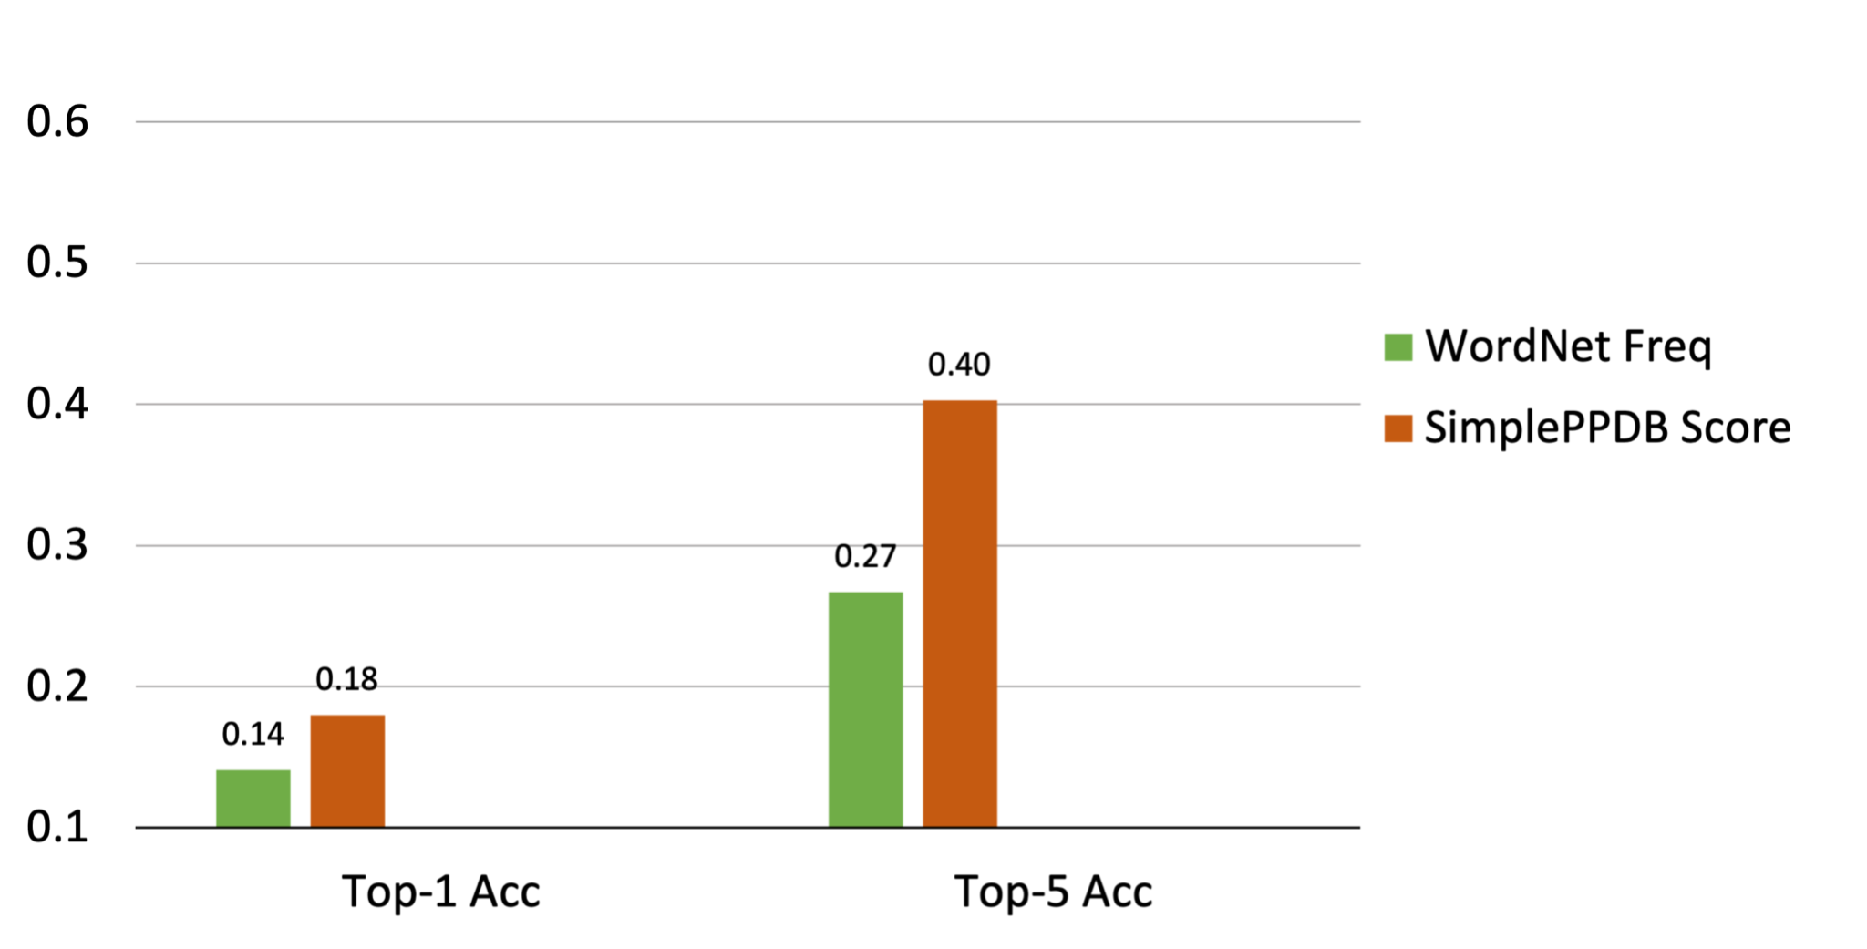
Lexical Substitution: Results
Notes:
For our results, we report both top-1 accuracy and the top-5 accuracy. Top-1 accuracy means that the highest-ranked substitute by a model was the correct simplification, while Top-5 accuracy means that the correct simplification was found in the top-5 ranked substitutes. We can see here that of our non-contextual baselines, SimplePPDB score clearly outperforms WordNet; this is likely due to the better overall coverage of SimplePPDB.

Slide 32
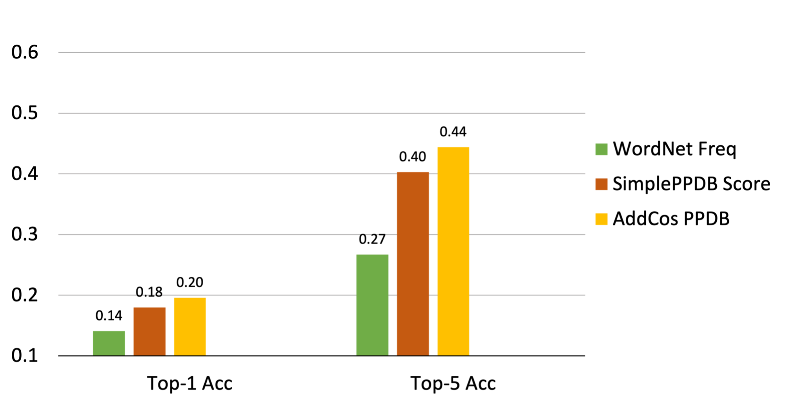
Lexical Substitution: Results
Notes:
When we take into account context and use PPDB substitutes as candidates, we gain a small amount over the non-contextual baselines.

Slide 33
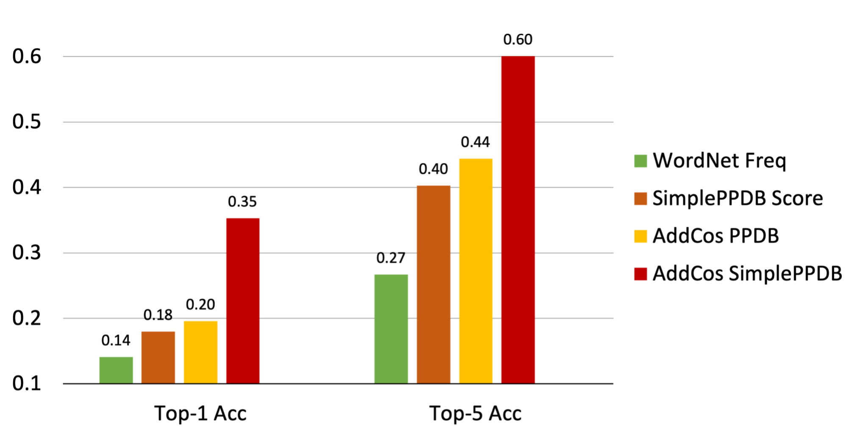
Lexical Substitution: Results
Notes:
Finally, if we consider our approach, which involves ranking SimplePPDB paraphrases using AddCos, we see a large improvement over the baselines.

Slide 34
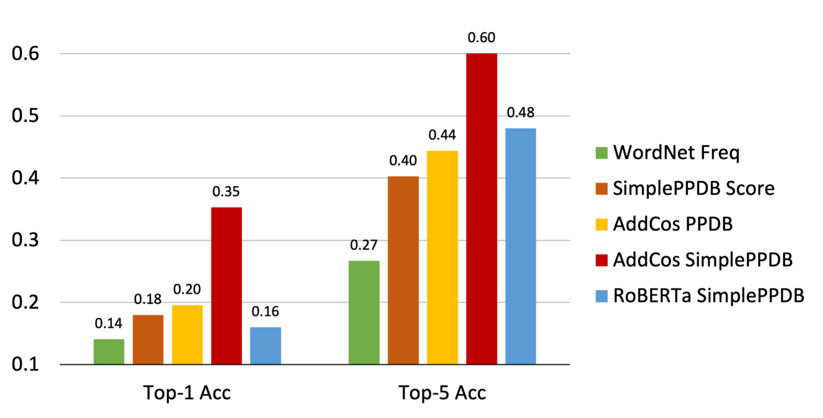
Lexical Substitution: Results
Notes:
Interestingly, ranking using RoBERTa does not result in further improvement. One potential reason for this is the fact that a context window of 1 was shown to be the most effective AddCos setting, while RoBERTa always takes into account the entire sentence.

Slide 35
Error Analysis
The identified complex word is part of a phrase and cannot be simplified on its own
Notes:
As our method is not perfect, I also discuss two categories of errors here, with more in my thesis. First, a complex word can be part of phrase, and thus should not be simplified on its own.

Slide 36
Error Analysis
The identified complex word is part of a phrase and cannot be simplified on its own
Word in Context
Officials will offer the lunch program at elementary schools.
basic
Bad Substitute
Notes:
In this example, our model identified that elementary is a complex word, which is sometimes true, but in this case it is part of the phrase “elementary schools”. Thus, attempting to replace elementary with basic in this context results in an error.

Slide 37
Error Analysis
Complex word has no good simpler substitute
Notes:
Another category of errors is when a complex word simply has no good simpler substitutes.

Slide 38
Error Analysis
Complex word generally has no good simpler substitute
Word in Context
Although the calculus may be different with Syrian refugees, the parallel for me is politics.
life, right, return, shelter, million
Bad Substitutes
Notes:
In this example, refugee cannot be replaced with a simpler word. Instead, we need to explain what refugees are here. This is a limitation I mentioned in the beginning of the talk. To address this type of error, we need to be able to identify which words or phrases represent complex concepts.

Slide 39
Thesis Outline
Simplification using Paraphrases and Context-based Lexical Substitution
Modeling and Evaluation of Sentence Simplification
Recasting Text Simplification as a Retrieval Task
Notes:
Next, we will discuss applying neural models to the task of sentence simplification, and how to better evaluate these sentence simplification systems.

Slide 40
Sequence-to-Sequence (Seq2Seq) Models
Only
use
neural
nets
Encoder (seq)
Slide from University of Pennsylvania Lecture for CIS 530 by John Hewitt and Reno Kriz.
Notes:
To talk about neural text simplification models, we first need to briefly discuss Sequence-to-Sequence, or Seq2Seq models in general. In a Seq2Seq model, we first “encode” the tokens of the input sentence into some vector representation. In this diagram, the pink rectangles represent the vector representations of each word in the input sentence. The orange rectangles represent the memory vector, or “state”. The blue ovals represent the function, usually a Recurrent Neural Network, which combines the word vector and the previous state to create a new intermediate state.

Slide 41
Sequence-to-Sequence (Seq2Seq) Models
Only
use
neural
nets
Decoder (2seq)
Encoder (seq)
Jiri
naanị
netwọk
nụ
Slide from University of Pennsylvania Lecture for CIS 530 by John Hewitt and Reno Kriz.
Notes:
Once we have a representation of the entire input, we can then generate an output sequence one word at a time. To generate the first word, we only use the input representation. For all subsequent words, we pass in both the input representation, along with the subsequence that the model has generated so far. Here, the task is translating from English to Yoruba, a very low-resource language; this task is shown because Seq2Seq models were first applied in NLP to machine translation. Note that this is the basic Seq2Seq model; subsequent improvements make this architecture more complicated. One significant extension is the additional of an attention mechanism, used so that while generating an output, a model can pay attention to each intermediate encoder step.

Slide 42
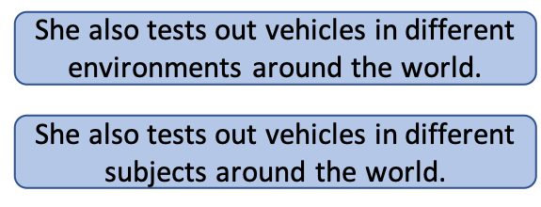
Problems with Seq2Seq
Copying directly from the original sentence
Complex
Seq2Seq
Notes:
The main problem with applying Sequence-to-Sequence models directly to simplification is that the most common operation when going from complex English to simple English is copying directly from the source. In the Newsela dataset mentioned before, Zhang and Lapata found that copying from the source sentence accounts for over 70% of the tokens in the output sentence. A vanilla Seq2Seq model learns this pattern very well, and often ends up producing outputs that make only trivial changes to the source sentence.

Slide 43
Problems with Seq2Seq
Copying directly from the original sentence
Previous solutions
Reinforcement learning (Zhang and Lapata, 2017)
Memory augmentation (Zhao et al., 2018)
Complex
Seq2Seq
Notes:
Previous works have attempted to encourage the model to make more non-copying changes, through either reinforcement learning or explicit lexical simplification via memory augmentation. However, these methods still tend to generate outputs that are longer and more complex than the reference simple sentences.

Slide 44
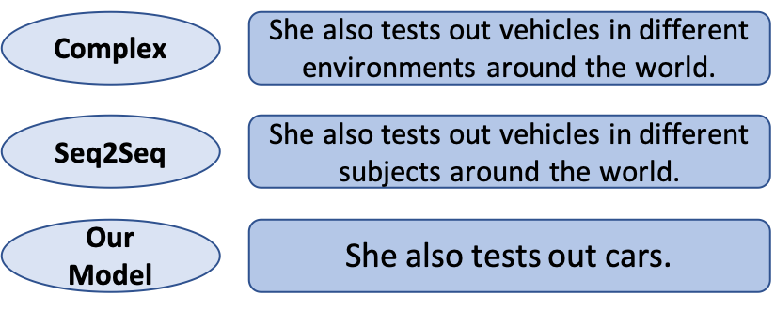
Proposed Solutions
Complex
Seq2Seq
Our Model
Notes:
In our work, we propose several changes to the Seq2Seq framework, both during training and during inference.

Slide 45
Proposed Solutions
Accounting for word complexity during training
Complex
Seq2Seq
Our Model
Notes:
During training, we augment our loss function to take into account word complexities

Slide 46
Proposed Solutions
Accounting for word complexity during training
Generating multiple diverse output sequences
Complex
Seq2Seq
Our Model
Notes:
Post-training, rather than generating a single output sequence, we can generate multiple diverse output.

Slide 47
Proposed Solutions
Accounting for word complexity during training
Generating multiple diverse output sequences
Re-ranking candidate simplifications
Complex
Seq2Seq
Our Model
Notes:
In order to effectively leverage our candidate outputs, we propose several re-ranking mechanisms. I’ll go into each other these in more detail.

Slide 48
Modified Loss Function
Notes:
During training, standard Seq2Seq uses cross entropy loss as the loss function. This function treats all tokens in the simplified sentence as equally important.

Slide 49
Modified Loss Function
Propose a complexity-weighted loss function (CWL)
Places more weight on getting the simpler words correct
Notes:
We instead propose to augment standard cross-entropy loss to place more weight on getting simpler words correct, and less weight on getting more complex words right.

Slide 50
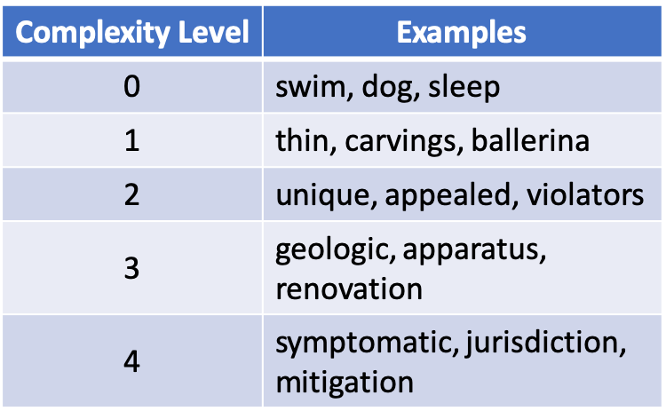
Modified Loss Function
Propose a complexity-weighted loss function (CWL)
Places more weight on getting the simpler words correct
Predict complexity with a linear regression model
Notes:
We predict the complexity of each word by training a linear regression model on words found most commonly in the different Newsela complexity levels. The table on the right show examples of words identified to be each level.

Slide 51
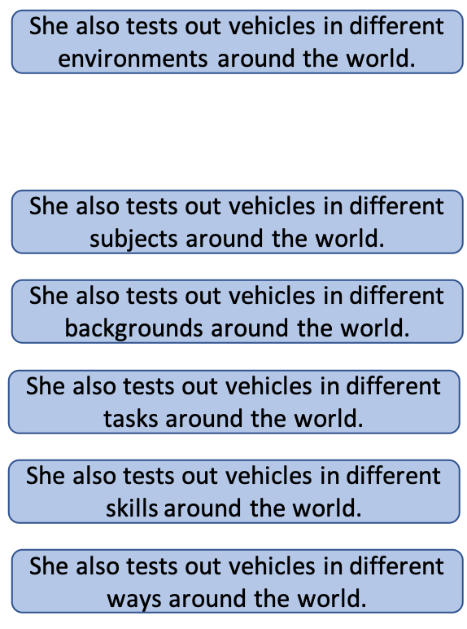
Diverse Decoding
Complex
Beam search generates candidates with only minor differences (Vijayakumar et al., 2016)
Beam Search
Notes:
A standard way to generate multiple candidate output sequences for a Sequence-to-Sequence is to use beam search. This involves generating the k most likely starting words, then generating the k most likely subsequences starting with one of these parent sequences. This process continues until we have k complete output sequences. Despite it being commonly used, beam search tends to only generate candidates with extremely minor differences in morphology or punctuation. In this example, we see that only one word was changed each time.

Slide 52
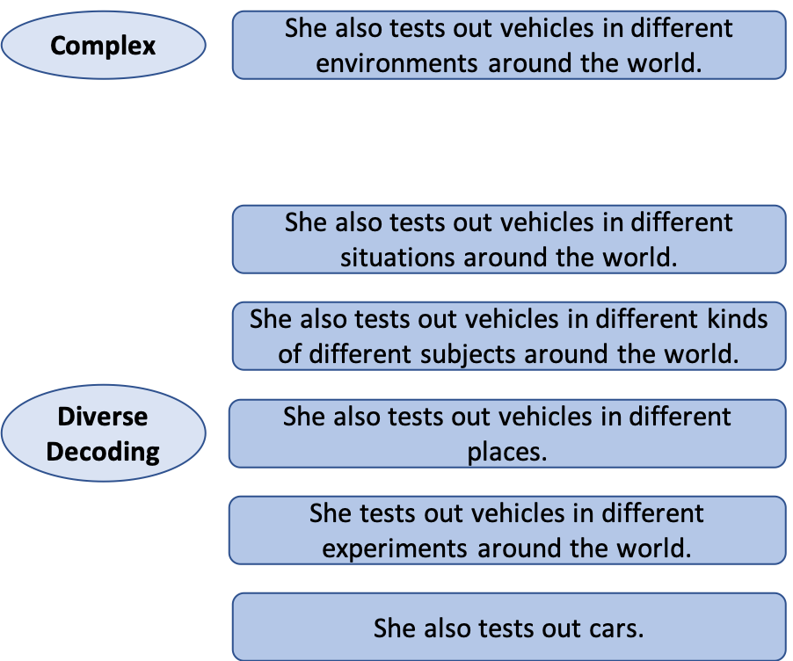
Diverse Decoding
Complex
Augment beam search scores to penalize candidates from the same parent subsequence (Li et al, 2016) (DeDiv)
Diverse Decoding
Notes:
In this work, we modify beam search scores to penalize candidates from the same parent subsequence. This forces the model to not get stuck generating outputs from the same parent subsequence, allowing us to generate more diverse outputs. In this example, we see that the fifth-most likely sequence is significantly shorter than the others, as it removes two prepositional phrases and simplifies vehicles to cars.

Slide 53
Diverse Decoding
Complex
Augment beam search scores to penalize candidates from the same parent subsequence (Li et al, 2016) (DeDiv)
Propose a method for clustering similar outputs after decoding (PDC)
Diverse Decoding
Notes:
To further increase diversity, we propose to over-generate candidate outputs during decoding, and cluster similar outputs together based on their sentence-level embeddings. Generating diverse candidates has been a widely-researched area in NLP recently, and I explore further the efficacy of a variety of diverse decoding methods in Chapter 5 of my thesis, which is based on a co-authored paper with Daphne Ippolito.

Slide 54
Post-decoding Re-ranking (PDR)
Notes:
In order to fully take advantage of generating multiple candidates for sentence simplification we need to pair it with an effective re-ranker. We propose to re-rank candidates based on three components, similar to the dimensions of simplification human evaluations.

Slide 55
Post-decoding Re-ranking (PDR)
Fluency
Perplexity based on a 5-gram language model
Notes:
The first dimension is fluency, which measures the grammaticality of a simplified sentence. To approximate this, we compute the perplexity of the output, as determined by a 5-gram language model trained on the English gigaword corpus.

Slide 56
Post-decoding Re-ranking (PDR)
Fluency
Perplexity based on a 5-gram language model
Adequacy
Cosine similarity between sentence representations of input and output
Notes:
Next, we consider adequacy, which involves how well the output preserves the meaning of the original sentence. We estimate this by generating sentence-level embeddings for the input and output sequences, and compute the cosine similarity.

Slide 57
Post-decoding Re-ranking (PDR)
Fluency
Perplexity based on a 5-gram language model
Adequacy
Cosine similarity between sentence representations of input and output
Trained CNN to predict the sentence-level complexity of the output
Complexity
Notes:
Finally, we consider relative complexity, which involves measuring how much simpler an output sentence is compared to the original complex sentence. To estimate this, we train a convolutional neural network to predict the Newsela level of each output sequence.

Slide 58
Baseline Comparisons
Seq2Seq
Vanilla Seq2Seq model (Nisioi et al., 2017)
Notes:
We compare our methods to several baselines. The first is a vanilla sequence-to-sequence model with attention.

Slide 59
Baseline Comparisons
Seq2Seq
Vanilla Seq2Seq model (Nisioi et al., 2017)
Performs splitting and deletion before applying a phrase-based machine translation system (Narayan and Gardent, 2014)
Hybrid
Notes:
The second is a combination system known as Hybrid. This model performs sentence splitting and deletion separately, before applying a phrase-based machine translation system

Slide 60
Baseline Comparisons
Seq2Seq
Vanilla Seq2Seq model (Nisioi et al., 2017)
Performs splitting and deletion before applying a phrase-based machine translation system (Narayan and Gardent, 2014)
Hybrid
DRESS
Seq2Seq with reinforcement learning (Zhang and Lapata, 2017)
Notes:
The third and most important baseline is the DRESS model by Zhang and Lapata, which augments the Sequence-to-Sequence framework with reinforcement learning in order to reward the model for making non-copy operations. This is somewhat analogous to our work, the key difference is their reward is during training, while our main reward functions are at inference time.

Slide 61
Baseline Comparisons
Seq2Seq
Vanilla Seq2Seq model (Nisioi et al., 2017)
Performs splitting and deletion before applying a phrase-based machine translation system (Narayan and Gardent, 2014)
Hybrid
DRESS
Seq2Seq with reinforcement learning (Zhang and Lapata, 2017)
DMASS
Transformer with memory augmentation (Zhu et al., 2018)
Notes:
The final baseline is DMASS, the first work to apply the popular Transformer model to text simplification, augmented with additional memory to aid in performing lexical simplification. Transformers is an extension to the Sequence-to-Sequence framework that relies solely on attention.

Slide 62
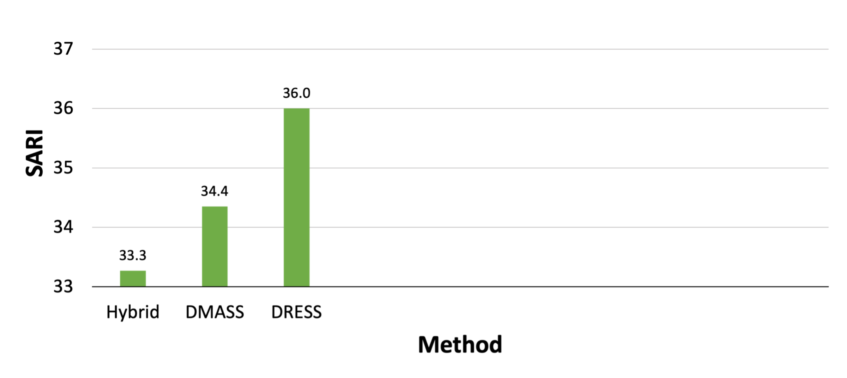
Results: Automatic Evaluation
Notes:
Using the standard automatic metric SARI, which we’ll discuss later on, of the three baselines that are separate models, DRESS performs significantly better than the other two.

Slide 63
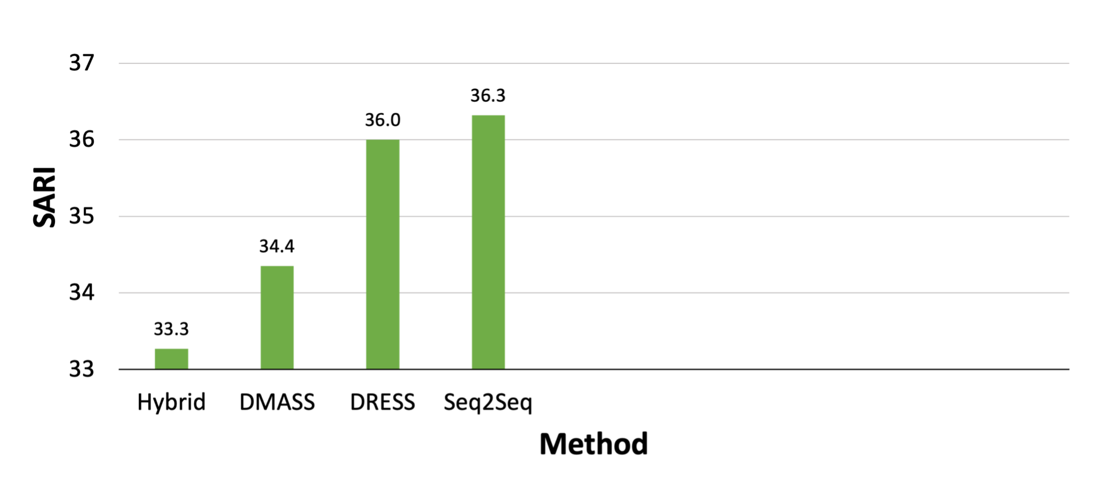
Results: Automatic Evaluation
Notes:
Surprisingly, our implementation of the vanilla Seq2Seq model with attention performs comparably to the strongest other baseline, DRESS.

Slide 64
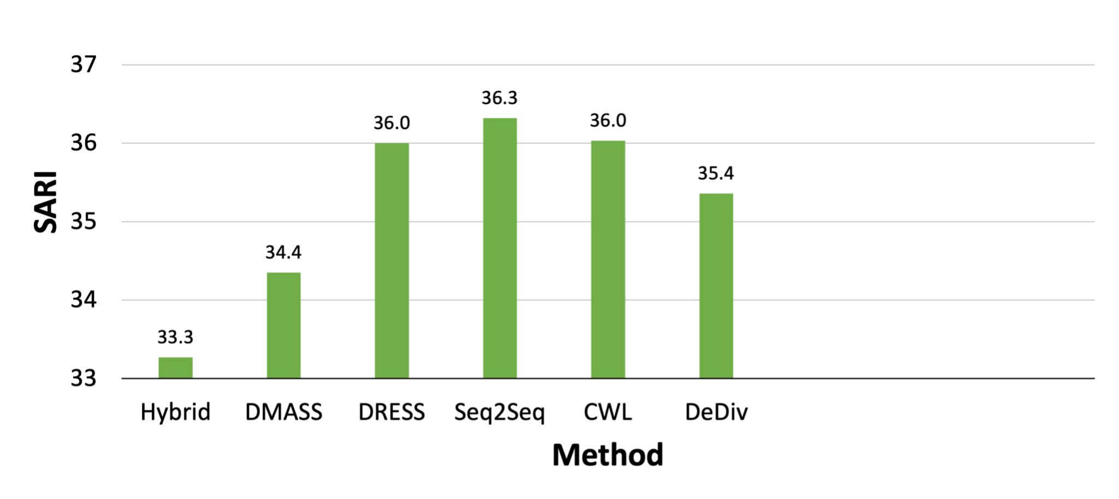
Results: Automatic Evaluation
Notes:
We see a slight decrease in SARI performance for our complexity weighted loss function, as well as our diverse decoding on its own.

Slide 65
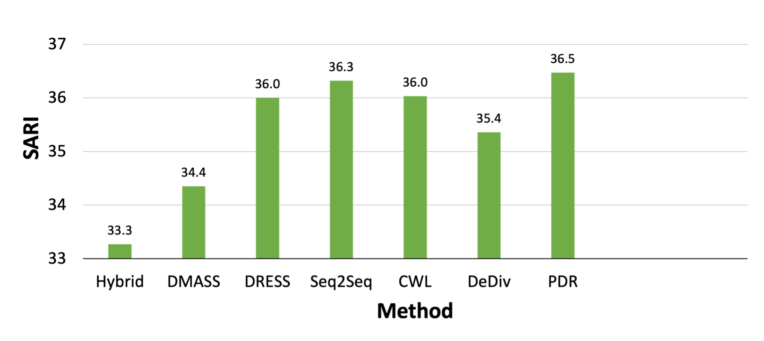
Results: Automatic Evaluation
Notes:
However, post-decoding re-ranking by itself improves performance.

Slide 66
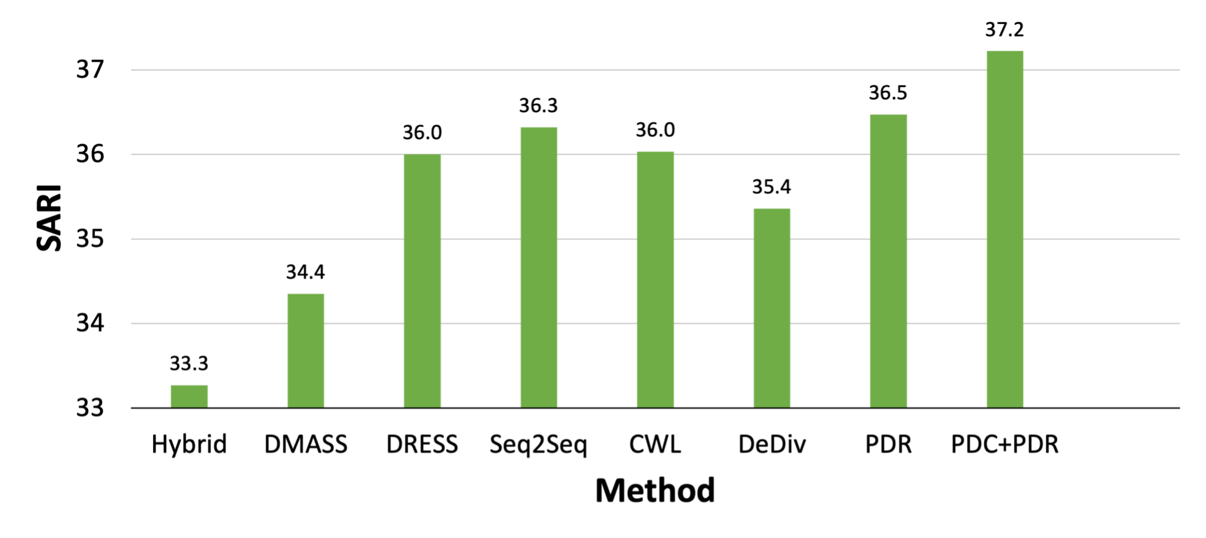
Results: Automatic Evaluation
Notes:
This is further boosted when additionally incorporating post-decoding clustering.

Slide 67
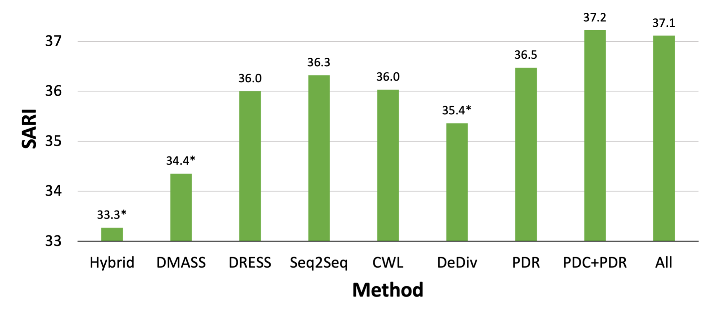
Results: Automatic Evaluation
Notes:
Adding in all additions results in similar performance. Stars here indicate methods with statistically significantly worse performance than our best model. While the results are promising, automatic simplification metrics often do not correlate well with human-judged quality, a phenomenon I’ll explore more in a few slides.

Slide 68
Results: Human Evaluation
Notes:
Because of this issue, we also run an additional evaluation to compare methods using human judgments directly. We asked 5 annotators to evaluate the quality of various model outputs for 200 sentences from our test set. We use the three dimensions of fluency, adequacy, and relative complexity, asking annotators to rate each of these on a scale from 1 to 5.

Slide 69
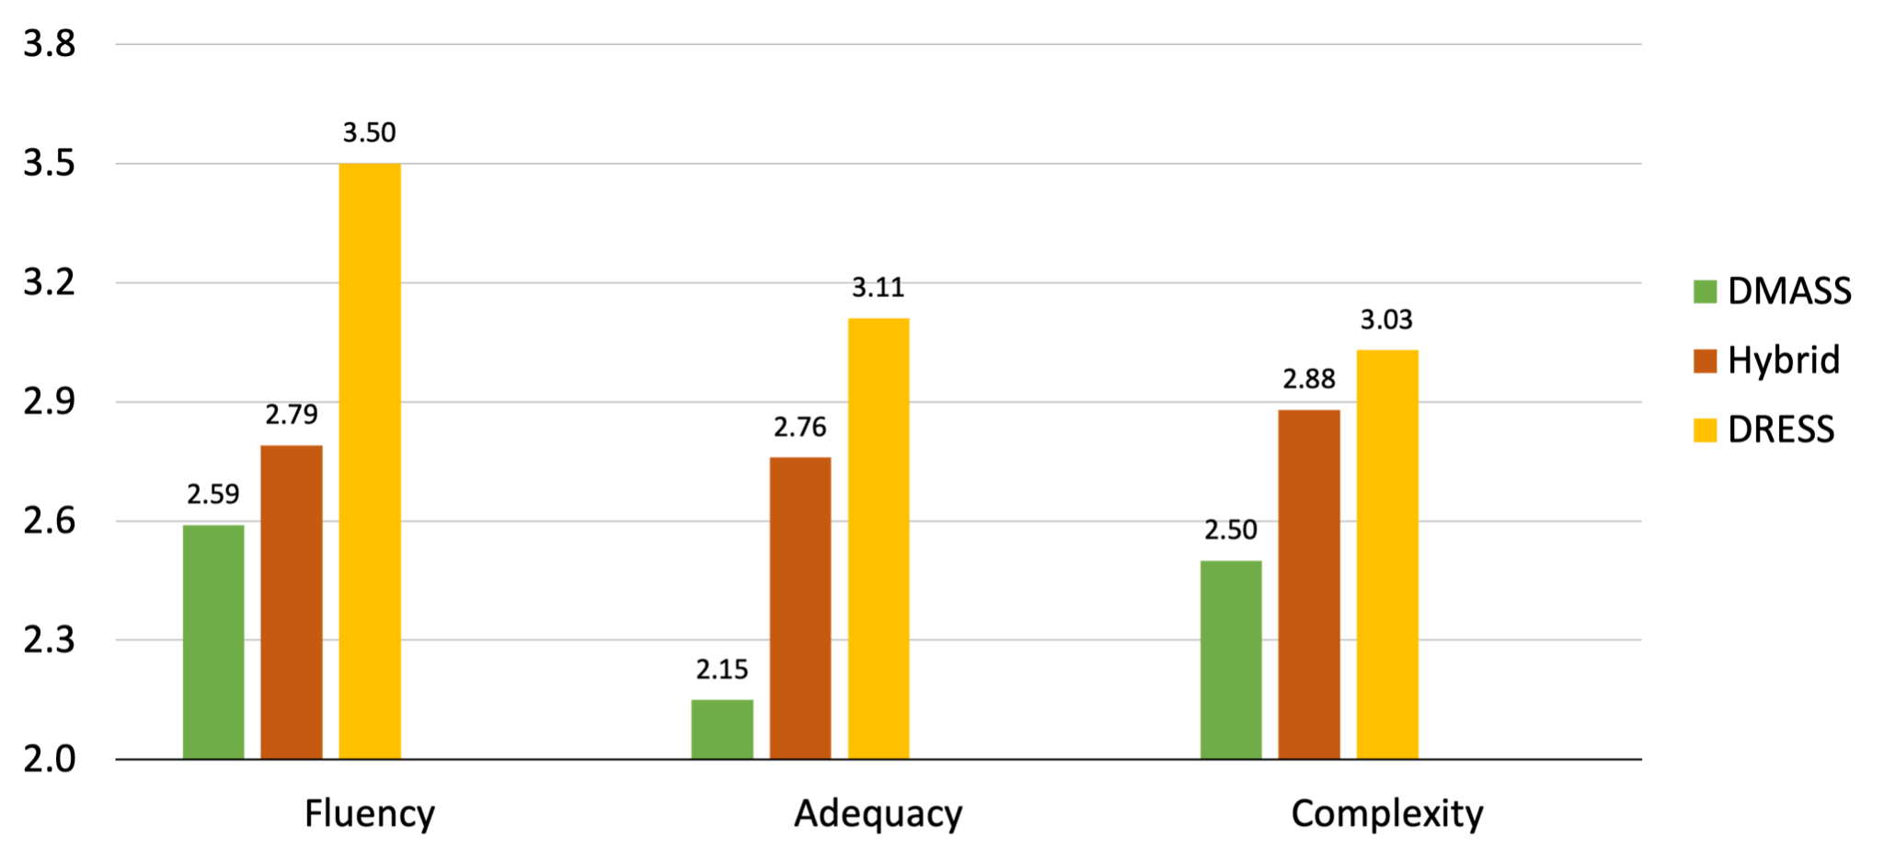
Results: Human Evaluation
Notes:
Of our three main baselines, DRESS again strongly outperforms the other two. It’s interesting that DMASS performs so poorly here, as transformer networks have shown improved performance on many NLP tasks. However, one thing to note here is that transformers are very sensitive to hyperparameter tuning, so it is likely that this model could have worked better. Subsequent implementations of transformers for sentence simplification do in fact lead to much better human performance.

Slide 70
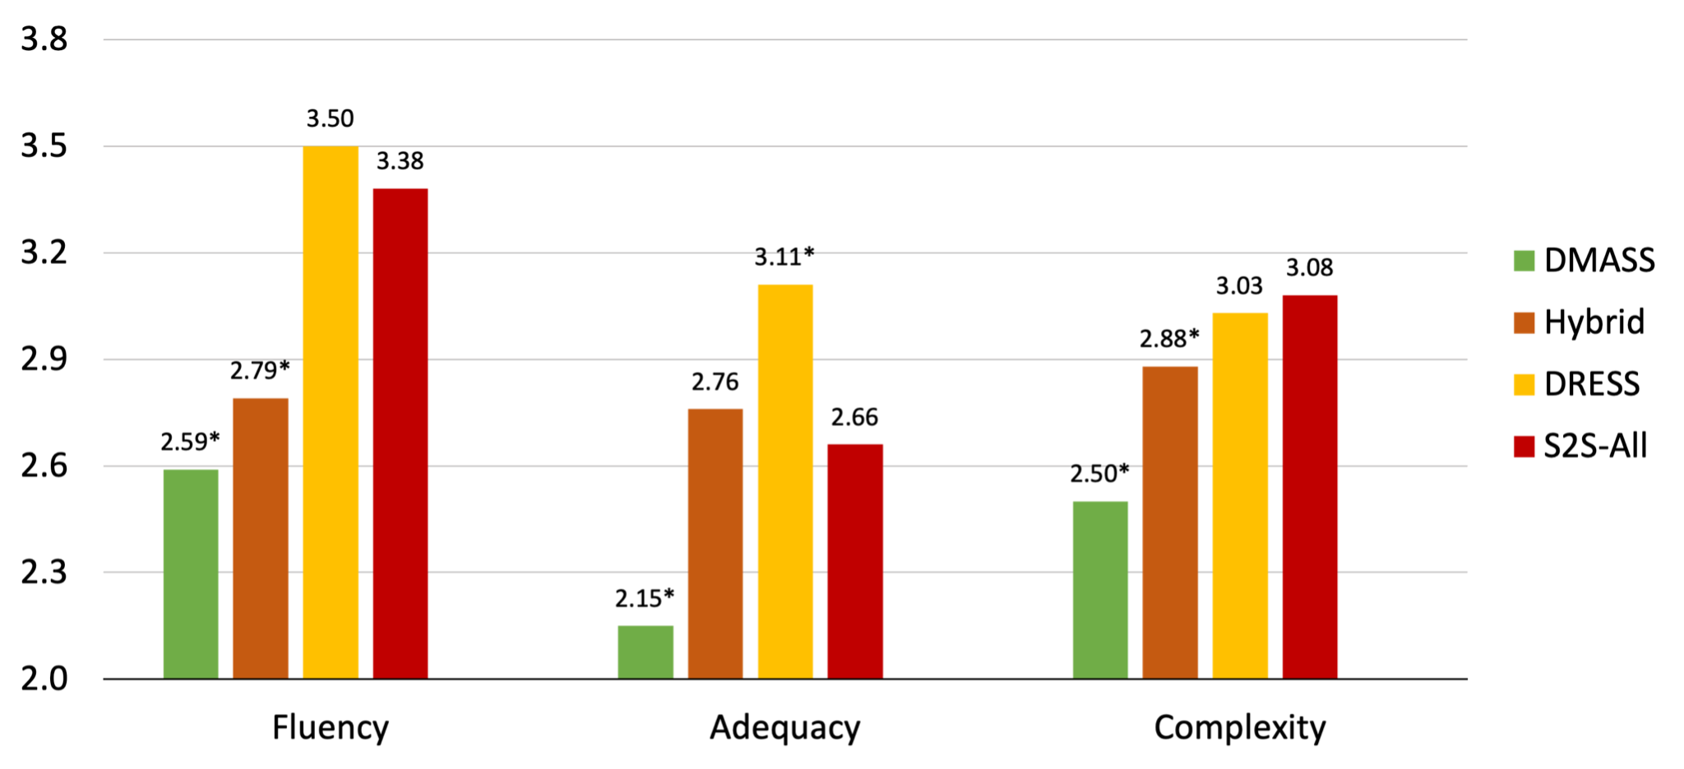
Results: Human Evaluation
Notes:
Our model slightly outperforms other baselines in terms of relative complexity, while remaining competitive in fluency, though it does see a drop in adequacy. The stars denote baselines that have statistically significantly different performance from our Seq2Seq model.

Slide 71
Results: Human Evaluation
DRESS length:
14.4 tokens
S2S length:
10.8 tokens
vs.
Notes:
One potential reason for this is our model generates much shorter sentences than DRESS, and length has been shown to have a strong effect on human adequacy judgments in the related task of sentence compression. To see if this is the case for simplification, rather than simply taking the highest-ranked sentence, we instead consider the highest-ranked sentence that matches the length of Dress-LS.

Slide 72
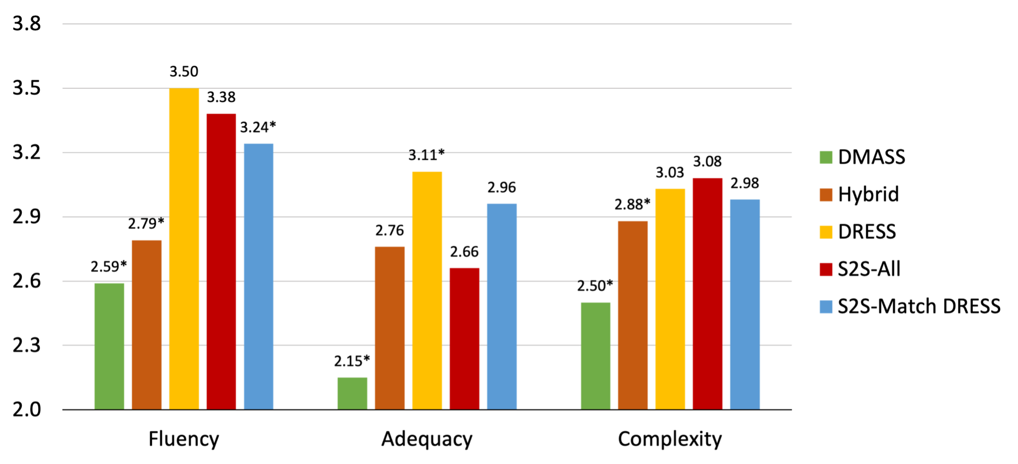
Results: Human Evaluation
Notes:
With this, we see that adequacy judgments of the longer sentences are indeed higher than our previous results, though this does come at the cost of some fluency and relative complexity.

Slide 73
Error Analysis
Notes:
Beyond showing several examples of where our model does well, we again perform a detailed error analysis. I’ve include two categories here, and explore several more in my thesis.

Slide 74
Error Analysis
Poor substitution due to word embedding proximity
In Beijing kite circles, Fei is widely known as the elder statesman.
Complex
Notes:
The first error category involves making poor substitutions.

Slide 75
Error Analysis
Poor substitution due to word embedding proximity
In Beijing kite circles, Fei is widely known as the elder statesman.
Complex
Our Model
In Beijing, Fei is considered a doctor.
Notes:
Here, statesman is incorrectly replaced with doctor. This specific error is likely due to Newsela simplification guidelines recommending that editors simplify many technical jobs to just doctor. This type of error can likely be alleviated with better initial word embeddings, as well as more training data.

Slide 76
Error Analysis
Long and complex sentences with multiple clauses
Wal-Mart, which imports more fruits and vegetables from Mexico than any other U.S. company, announced its effort to force improvements up and down its supply chain.
Complex
Notes:
The next error category is a bit more concerning, involving the difficulty of simplifying long and complex sentences with multiple clauses. Here, we we probably should split up the initial sentence into several shorter sentences.

Slide 77
Error Analysis
Long and complex sentences with multiple clauses
Wal-Mart, which imports more fruits and vegetables from Mexico than any other U.S. company, announced its effort to force improvements up and down its supply chain.
Complex
Our Model
Wal-Mart used more fruits and vegetables from the company.
Notes:
However, our model instead simply chooses one part of the sentence, and removes the rest. To make matters worse, here it chose a supplementary clause. This is partially due to our training data having very few instances of sentence splitting, but beyond this, it is well known that sequence-to-sequence models tend to struggle with longer input sequences.

Slide 78
Current Evaluation Metrics
BLEU (Papineni et al., 2002)
Counts the number of overlapping n-grams
Notes:
So far in this section, we showed that our modifications to Seq2Seq models resulted in better performance according to automatic metrics, but the human evaluation was not as clear. Common automatic evaluation metrics used in simplification include BLEU, an MT-based metric that counts the number of overlapping n-grams between the complex and simple sentences.

Slide 79
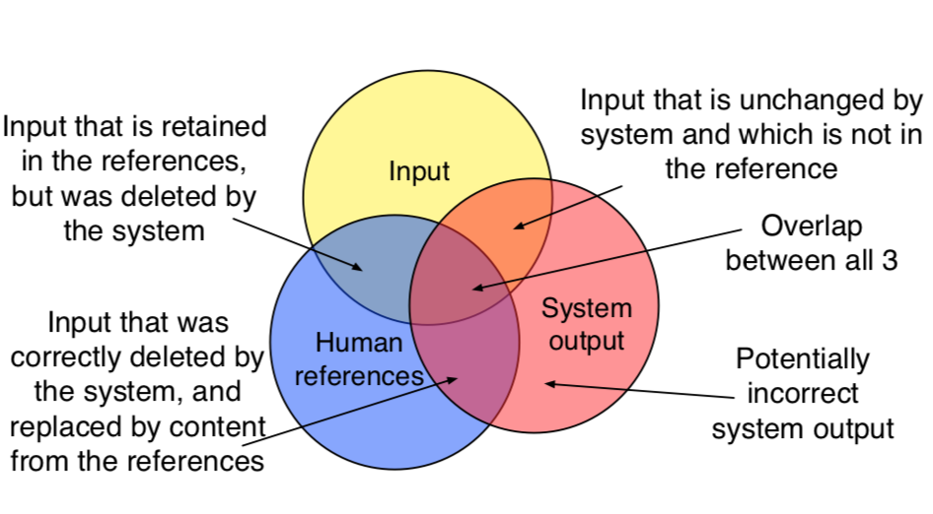
Current Evaluation Metrics
BLEU (Papineni et al., 2002)
Counts the number of overlapping n-grams
SARI (Xu et al., 2016)
Counts how often the output correctly keeps, deletes, and adds n-grams
Illustration of SARI (Xu et al., 2016)
Notes:
The main metric, used both in our work and most other sentence simplification papers is SARI, which calculates how often the generated simple sentence correctly keeps deletes, and adds n-grams. This can be considered an extension of BLEU which also takes into account the original complex sentence.

Slide 80
Simplification Evaluation Metrics: Limitations
Low correlation with human judgments
BLEU negatively correlates with deletion (Sulem et al., 2018)
Notes:
As we’ve seen, while these automatic metrics have correlated well with human judgments on some tasks, this is not always the case for sentence-level simplification. In particular, a recent work showed that BLEU actually negatively correlates with deletion, a key component of simplification, because it has a brevity penalty.

Slide 81
Simplification Evaluation Metrics: Limitations
Low correlation with human judgments
BLEU negatively correlates with deletion (Sulem et al., 2018)
Require 1+ reference simple sentences
Notes:
Beyond this, these metrics also require one or ideally multiple reference simple sentences, which can be expensive to obtain.

Slide 82
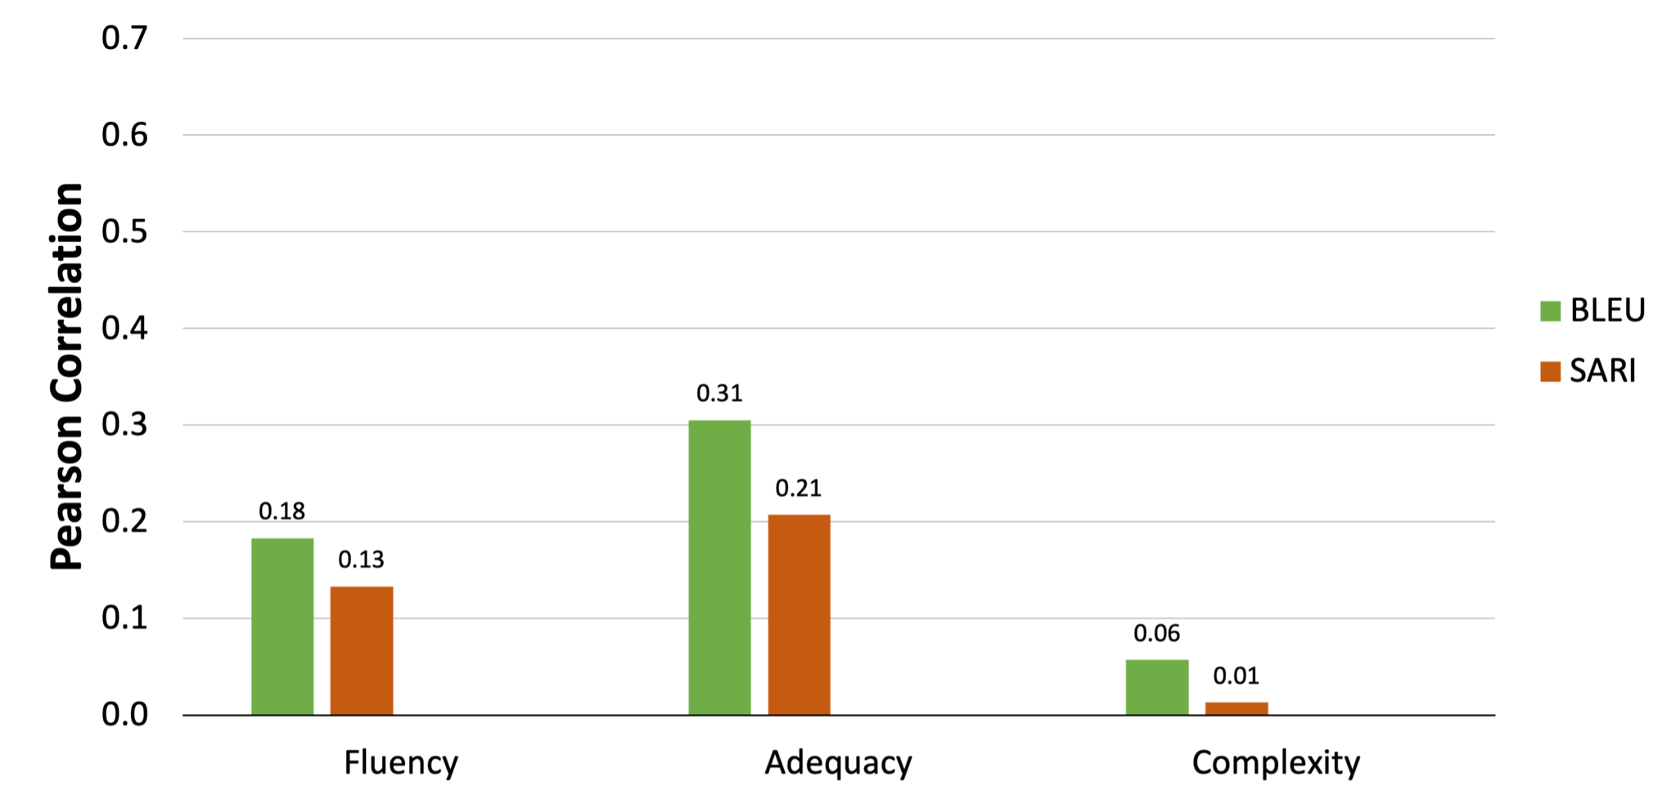
Simplification Evaluation Metrics: Results
Notes:
These are correlations of BLEU and SARI with the human judgments collected earlier in this section. As we can see, both metrics have relatively low correlation with all three dimensions we want to evaluate for in sentence simplification.

Slide 83
BERT-based Quality Estimation (Xenouleas et al., 2019)
Sum-QE: Rates summaries with respect to five linguistic qualities
Notes:
One way to get around the issues of previous metrics is by training a quality estimation model. In summarization, Xenouleas et al. fine-tuned BERT, a state-of-the art contextual language model, to accurately rate summaries with respect to five linguistic qualities. This work extended the general fine-tuning process to predict all five qualities simultaneously. This can allow for further improvement when multiple dimensions are correlated.

Slide 84
BERT-based Quality Estimation (Xenouleas et al., 2019)
Sum-QE: Rates summaries with respect to five linguistic qualities
S_{Fluency}
S_{Adequacy}
S_{Complexity}
ℜ₁
ℜ₂
ℜ₃
BERT
System Output
Notes:
Applying this to simplification, we pass the system output through the general BERT architecture, and then train three separate regression layers to predict each of simplification’s three dimensions.

Slide 85
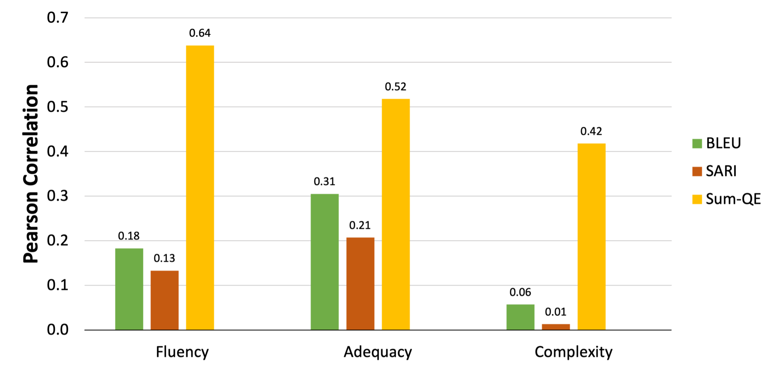
Simplification Evaluation Metrics: Results
Notes:
Here, we can see the results of directly applying Sum-QE to our task. To avoid seeing any part of the evaluation data during training, we fine-tune BERT using 10-fold cross validation.

Slide 86
Simplification QE: Method
Simple-QE: Extension of Sum-QE that takes reference complex sentence into account
Notes:
One limitation of Sum-QE when applying to simplification is that it only takes the output sequence into account. Thus, we propose to extend this architecture to account for both the original complex sentence and the generated simple sentence.

Slide 87
Simplification QE: Method
Simple-QE: Extension of Sum-QE that takes reference complex sentence into account
S_{Fluency}
S_{Adequacy}
S_{Complexity}
ℜ₁
ℜ₂
ℜ₃
BERT
BERT
Reference Complex
System Output
Simple-QE architecture, where each R represents a regressor layer.
Notes:
The updated model architecture is shown here; first we pass both the reference complex sentence and the system output through identical static BERT architectures. We then concatenate the outputs together before passing through the final regression layers.

Slide 88
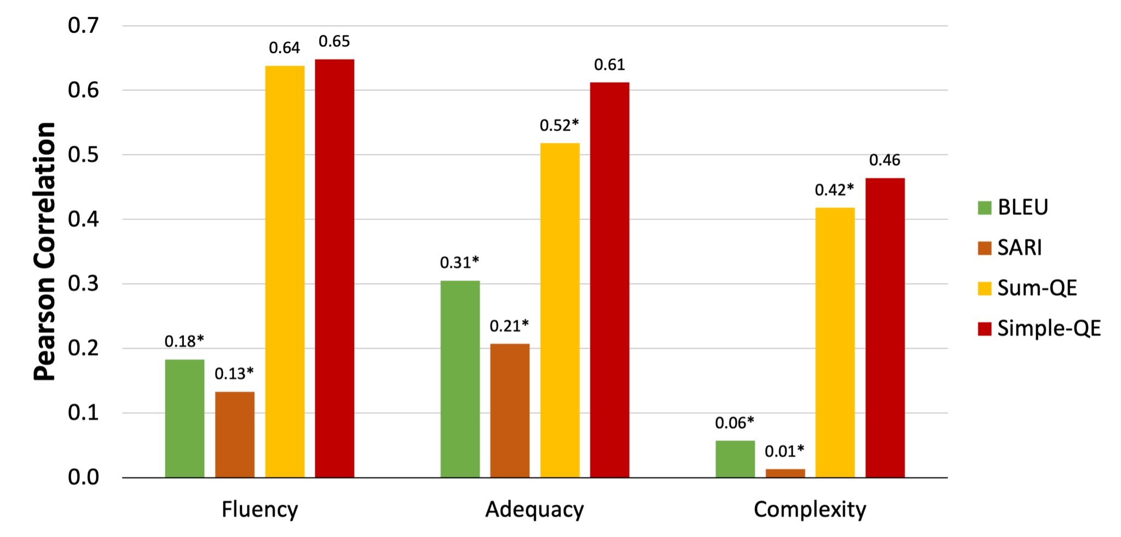
Simplification Evaluation Metrics: Results
Notes:
As we can see, this does not affect the correlation with fluency judgments; this makes sense, since we shouldn’t need the original complex sentence to estimate the fluency of the output. However, we do see a significant improvement on adequacy and relative complexity.

Slide 89
Thesis Outline
Simplification using Paraphrases and Context-based Lexical Substitution
Modeling and Evaluation of Sentence Simplification
Recasting Text Simplification as a Retrieval Task
Notes:
Finally, in the last section I will discuss limitations of current approaches, and propose a potential reformulation of the text simplification task

Slide 90
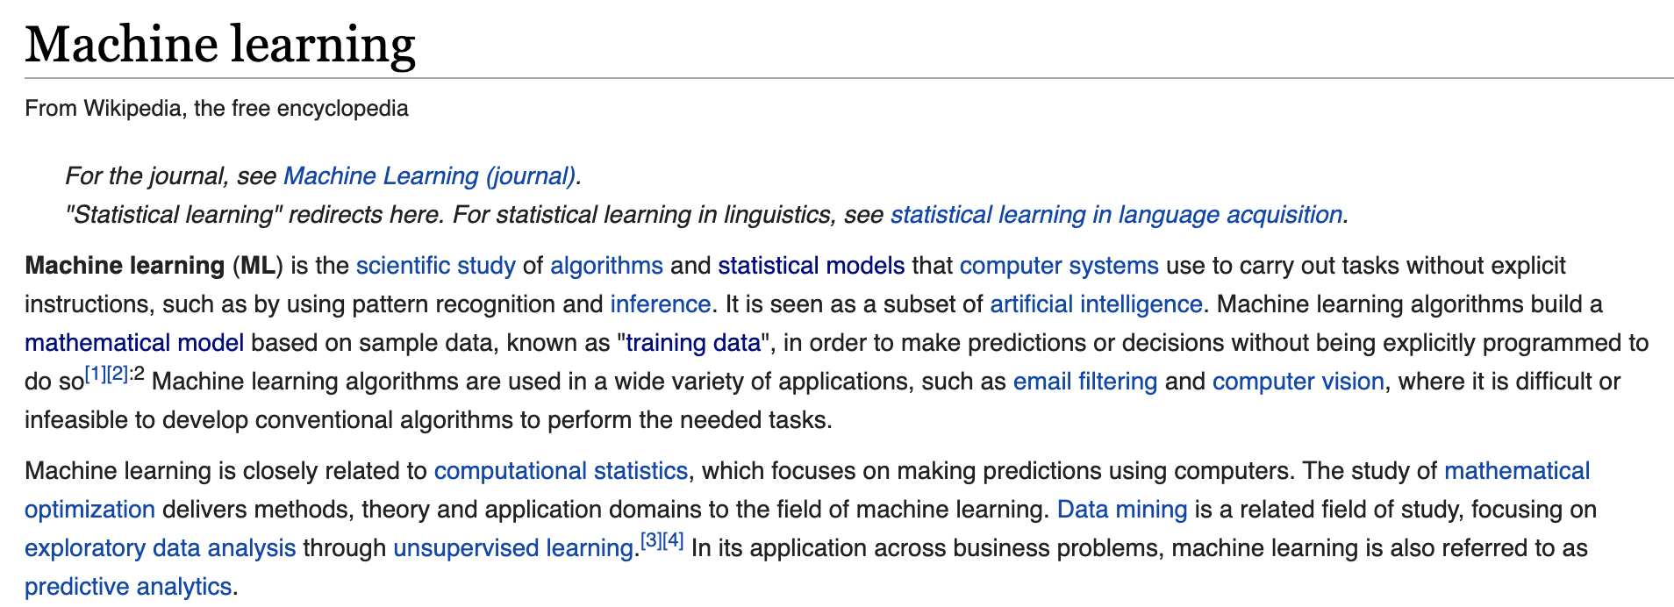
Motivating Example
Notes:
Let’s consider the machine learning wikipedia page as an example document. While this is not a super complex document, fully understanding this document does require an understanding of several relatively complex concepts.

Slide 91
Motivating Example
Notes:
For example, if we consider the phrase “sample data”, you cannot simply replace it with a simpler word or phrase. Instead you’d at least need to define it as “pieces of information collected from a population”.

Slide 92
Motivating Example
Notes:
Similarly, for algorithms, you need to at least define it as “a set of rules that precisely defines a sequence of operations”. However, for someone unfamiliar with computer science, this definition is likely not enough, and thus would require a longer and simpler description, potentially with examples. This is the motivation for reformulating the “text simplification” problem as an information retrieval task.

Slide 93
Reformulating as Information Retrieval Problem
Notes:
To make this more concrete, our formulation has the following steps.

Slide 94
Reformulating as Information Retrieval Problem
Critical concept identification
Notes:
First, given a document, we need to be able to identify concepts that are critical to understanding that document.

Slide 95
Reformulating as Information Retrieval Problem
Critical concept identification
Leveled document retrieval
Notes:
Next, given a text, we need to be able to find documents related to this concept. Ideally, we will be able to retrieve documents from a variety of difficulty levels about each topic.

Slide 96
Reformulating as Information Retrieval Problem
Critical concept identification
Leveled document retrieval
Document filtering
Notes:
Finally, we need to re-rank these documents based on their appropriateness for users with different backgrounds of understanding.

Slide 97
Reformulating as Information Retrieval Problem
Critical concept identification
Leveled document retrieval
Document filtering
Notes:
In this talk, I’ll focus on the document retrieval and filtering aspects of this problem.

Slide 98

Complexity-Sensitive Retrieval: Problem Setup
Input: a phrase, sentence, or document
Notes:
For our complexity-sensitive retrieval problem, we will start with some input text; this can be a phrase, a sentence, or an entire document.

Slide 99

Complexity-Sensitive Retrieval: Problem Setup
Input: a phrase, sentence, or document
k related texts at a variety of complexity levels
Notes:
As an intermediate step, we want to be able to generate a set of related texts, ideally from a variety of complexity levels.

Slide 100
Complexity-Sensitive Retrieval: Problem Setup
Input: a phrase, sentence, or document
k related texts at a variety of complexity levels
A filtered list of texts based on appropriateness
Notes:
Finally, we will filter this list based on their appropriateness

Slide 101
Complexity-Sensitive Retrieval: Initial Experiment
We can again use Newsela!
Notes:
To see if current retrieval approaches are feasible, we set up an initial experiment again relying on Newsela.

Slide 102
Complexity-Sensitive Retrieval: Initial Experiment
We can again use Newsela!
Input: each complex Newsela article D_{i4}
Notes:
As input, we use each complex Newsela article D_i4. Here, 4 represents the highest complexity level, L4.

Slide 103
Complexity-Sensitive Retrieval: Initial Experiment
We can again use Newsela!
Input: each complex Newsela article D_{i4}
All other articles, ranked by similarity to D_{i4}
Notes:
To rank all other articles in our corpus, we then compute the similarity between D_i4 and each other article. For this, we generate document-level embeddings for D_i4 and all other documents, and then compute cosine similarities. We use two models to generate these embeddings: BERT and SBERT. BERT, as mentioned before, is a state-of-the-art language model that can be used to generate high-quality word embeddings, which can be combined into a document-level representation. SBERT is a version of BERT that is explicitly fine-tuned on natural language inference data so that it can directly generate embeddings for sentences and larger texts.

Slide 104
Complexity-Sensitive Retrieval: Initial Experiment
We can again use Newsela!
Input: each complex Newsela article D_{i4}
All other articles, ranked by similarity to D_{i4}
The rank of the aligned Newsela articles D_{ij},
where 0 ≤ j ≤ 3
Notes:
To quantify how well each model performs, we compute the rank of each aligned Newsela article with D_i4; these are D_i0, D_i1, D_i2, and D_i3. For now, to make evaluation simpler, we only include one of these aligned article in the ranking at a time.

Slide 105
Complexity-Sensitive Retrieval: Initial Experiment
We can again use Newsela!
Since this is a relatively small corpus, we also include ~1 million New York Times articles as additional distractor documents
Input: each complex Newsela article D_{i4}
All other articles, ranked by similarity to D_{i4}
The rank of the aligned Newsela articles D_{ij},
where 0 ≤ j ≤ 3
Notes:
Since Newsela is a relatively small corpus, to make this retrieval task more challenging, as a second experiment we include over one million New York Times articles as additional distractor documents.

Slide 106
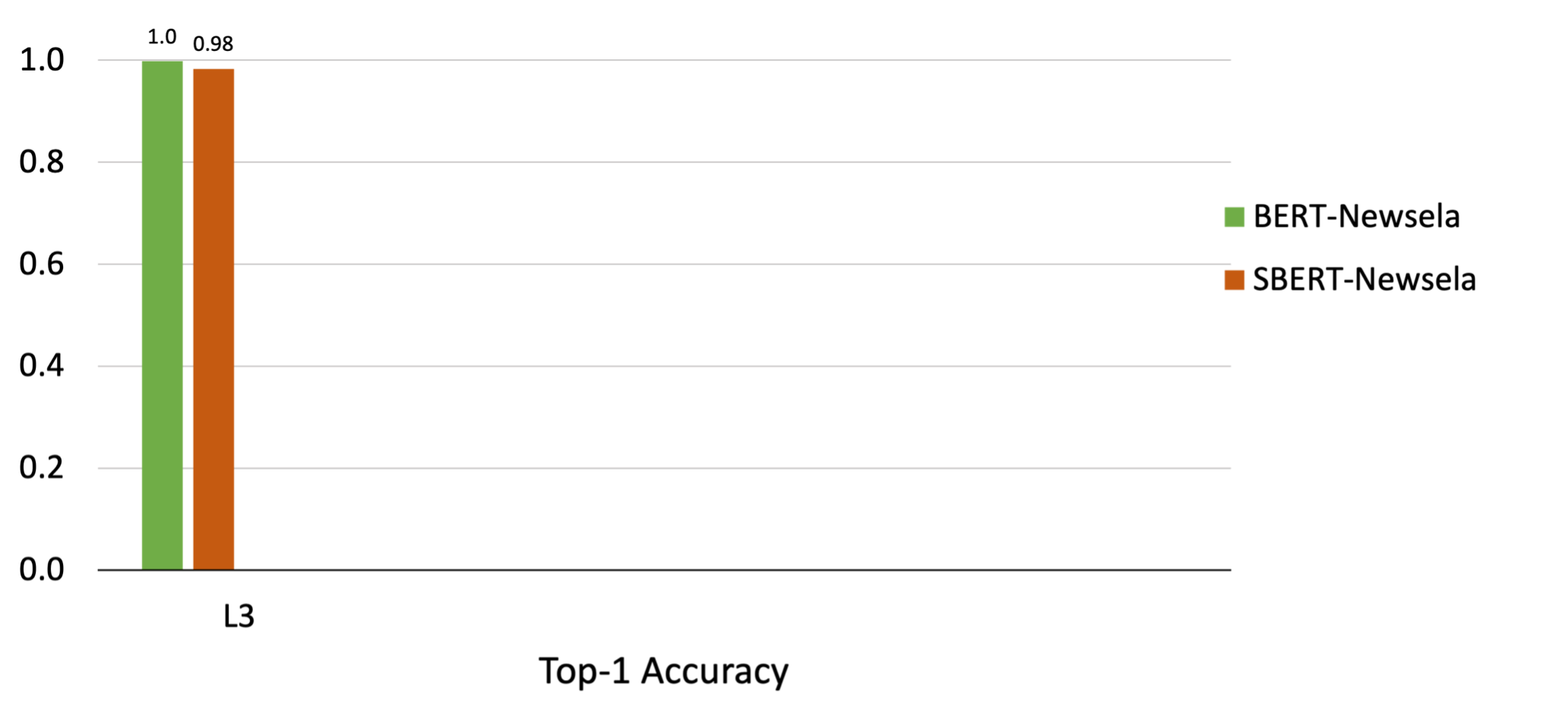
Complexity-Sensitive Retrieval: Results
Notes:
We show the results of both BERT and SBERT here. When attempting to retrieve the aligned L3 document, which is the version with the least amount of changes from the original L4 document, we see that both BERT and SBERT identify this document as the most relevant nearly 100% of the time.

Slide 107
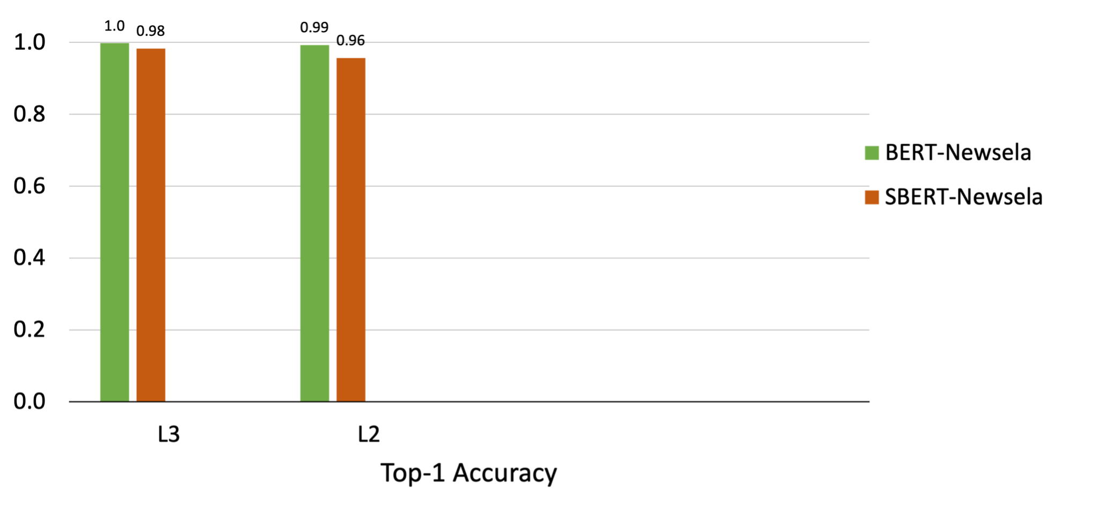
Complexity-Sensitive Retrieval: Results
Notes:
Retrieving the aligned L2 document shows similar results.

Slide 108
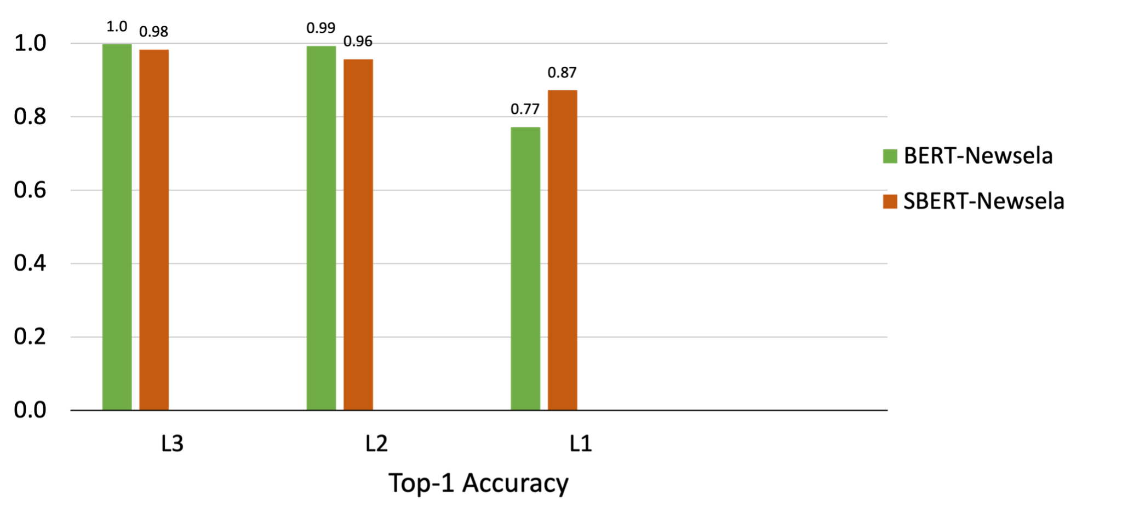
Complexity-Sensitive Retrieval: Results
Notes:
Retrieving the L1 document starts to show a decrease in performance, which is more notable for BERT.

Slide 109
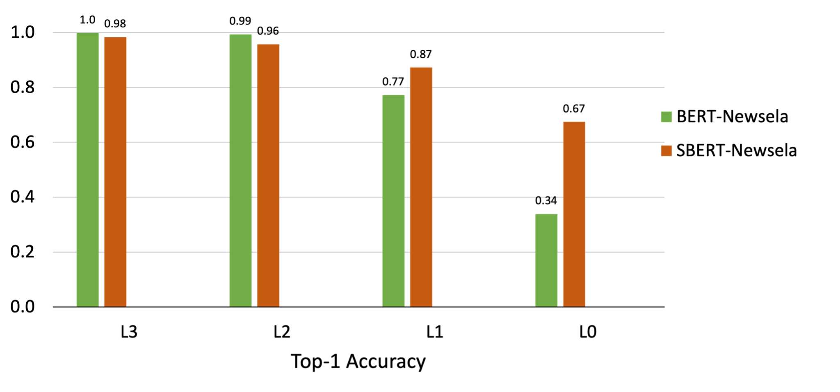
Complexity-Sensitive Retrieval: Results
Notes:
Finally, when retrieving the L0 document, the most simplified version, SBERT nearly doubles the performance of BERT, though both are significantly lower. SBERT performing better here makes sense, because it has explicitly been trained to better understand the semantic meaning of a larger text.

Slide 110
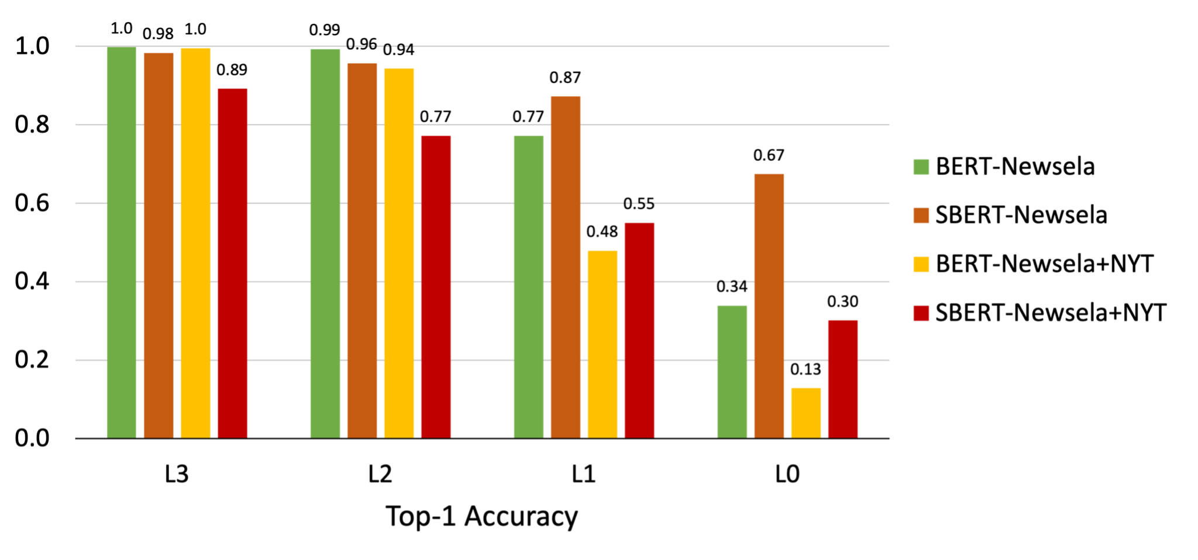
Complexity-Sensitive Retrieval: Results
Notes:
Adding in the New York Times distractor documents results in a similar trend. Here, BERT outperforms more strongly on retrieving the more complex aligned documents, while SBERT maintains its edge retrieving simpler aligned documents. The numbers here are lower overall, as this is a significantly more challenging retrieval task.

Slide 111
Complexity-Sensitive Retrieval: Problem with Results
In practice, there will not be only a single relevant document
Notes:
Beyond the decrease in performance in retrieving simpler aligned articles, An issue with this initial experiment is the fact that there is only one document that is relevant. However, in practice there can be multiple relevant documents.

Slide 112
Complexity-Sensitive Retrieval: Problem with Results
In practice, there will not be only a single relevant document
When considering all aligned documents at once, those written at lower complexity levels (D_{i2}, D_{i1}, D_{i0}) are rarely ranked highest
Known as the Keep All Aligned Documents evaluation approach, or KAAD
Notes:
To simulate this idea, in our next experiment we will include all aligned articles in the pool of documents to be retrieved from; we call this the KAAD approach, which stands for Keep all aligned documents. From the initial results, is pretty likely that aligned documents written at lower complexity level will not be ranked the highest.

Slide 113
Complexity-Sensitive Retrieval: Problem with Results
In practice, there will not be only a single relevant document
When considering all aligned documents at once, those written at lower complexity levels (D_{i2}, D_{i1}, D_{i0}) are rarely ranked highest
Known as the Keep All Aligned Documents evaluation approach, or KAAD
Need: A way to filter documents based on their complexity
Notes:
Thus, we need to be able to filter these relevant documents effectively depending on what level a user requires.

Slide 114
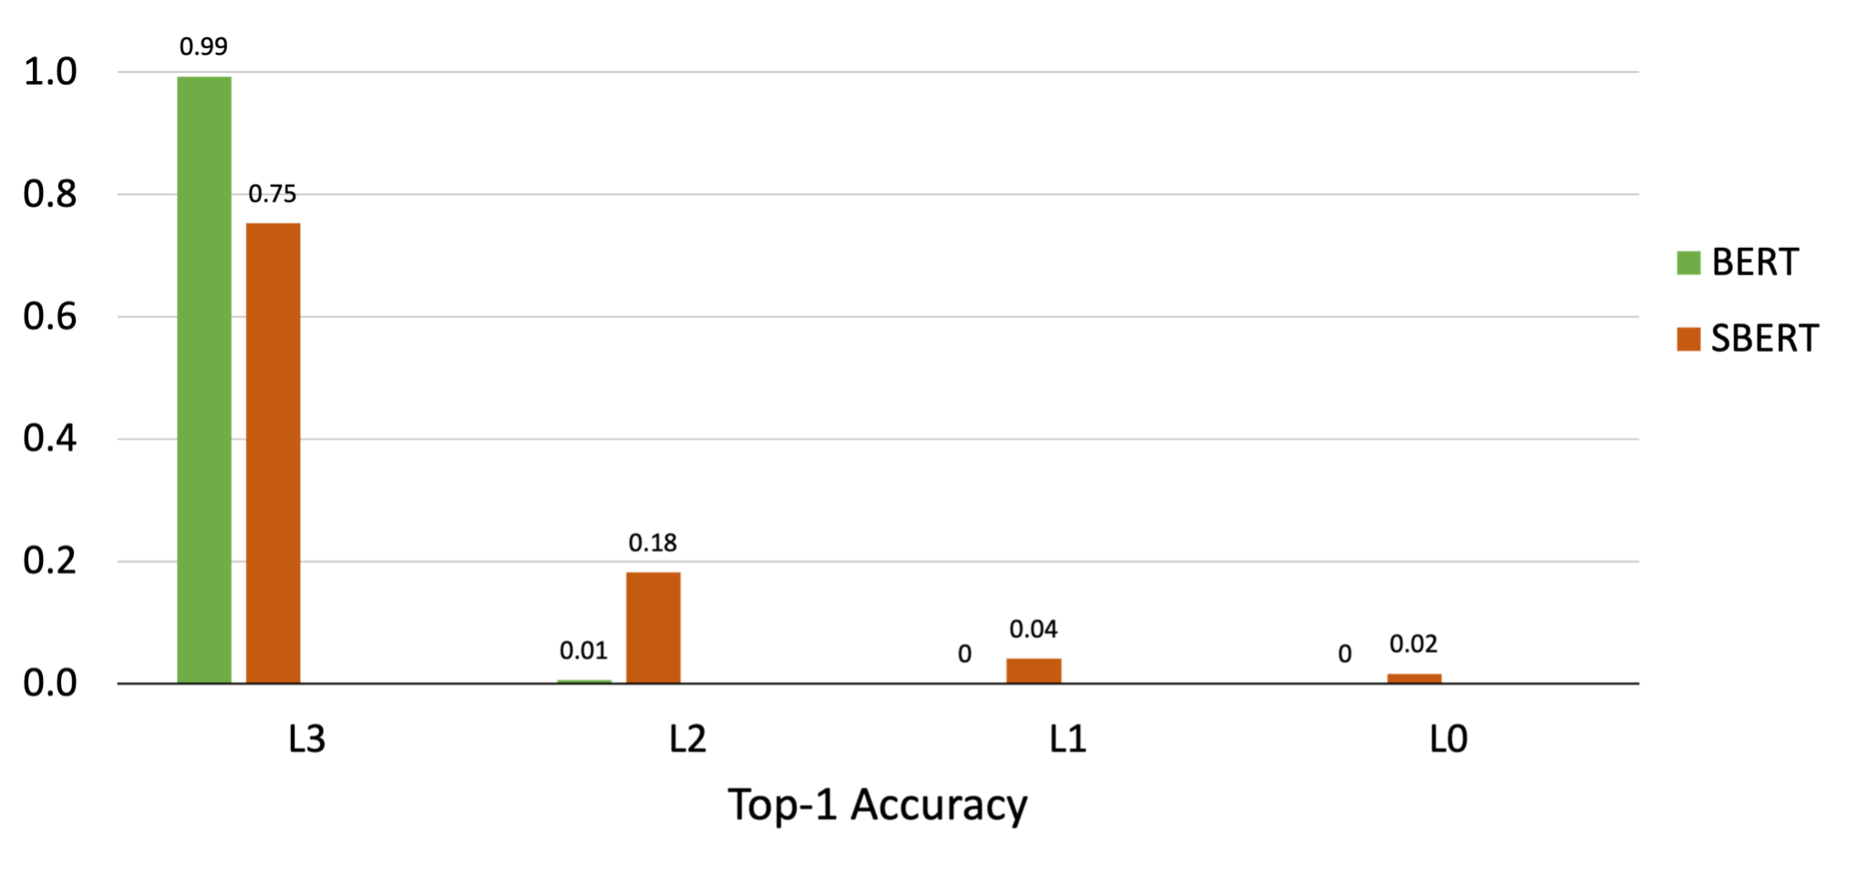
Complexity-Sensitive Retrieval: KAAD Newsela Results
Notes:
Without filtering, we can see that when using the KAAD approach to evaluate the retrieval of aligned documents, L3 aligned articles are still retrieved effectively. However, as expected, the aligned L2, L1, and L0 documents are almost never identified as the most relevant article.

Slide 115
Document-Level Complexity Prediction: Method
Use a fine-tuned BERT model to predict document complexity
Notes:
For our filtering technique, we again rely on fine-tuning BERT to predict document-level complexity.

Slide 116
Document-Level Complexity Prediction: Method
Use a fine-tuned BERT model to predict document complexity
Input Document
Notes:
We start with an input document.

Slide 117
Document-Level Complexity Prediction: Method
Use a fine-tuned BERT model to predict document complexity
Sub-doc₁
Input Document
⋮
Sub-doc_{k}
Notes:
As BERT can only process up to 512 subword units at a time, we split up each documents into sub-documents.

Slide 118
Document-Level Complexity Prediction: Method
Use a fine-tuned BERT model to predict document complexity
Sub-doc₁
BERT
ℜ
pred_complexity₁
Input Document
⋮
⋮
⋮
⋮
Sub-doc_{k}
BERT
ℜ
pred_complexity_{k}
Notes:
We then pass each sub-document through a fine-tuned BERT model to predict the Newsela complexity level.

Slide 119
Document-Level Complexity Prediction: Method
Use a fine-tuned BERT model to predict document complexity
Sub-doc₁
BERT
ℜ
pred_complexity₁
Input Document
⋮
⋮
⋮
⋮
Document Complexity
Sub-doc_{k}
BERT
ℜ
pred_complexity_{k}
Notes:
To generate a single document-level prediction, we take the most common predicted complexity level across sub-documents, weighted by sub-document lengths

Slide 120
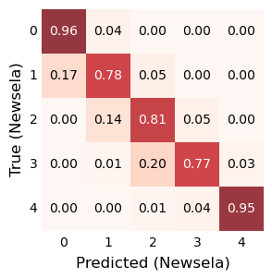
Document-Level Complexity Prediction: Results
Notes:
As we can see in this confusion matrix, our fine-tuned BERT model is extremely effective at predicting the complexity level of Newsela articles. In my thesis, I discuss that this effectiveness does not easily transfer to other domains, but these results are at least quite promising for this experimental setup.

Slide 121
Complexity-Sensitive Retrieval: KAAD Newsela Results
Notes:
Just to remind us of where we started, again we see that without filtering we cannot identify the simpler aligned documents as the most relevant.

Slide 122
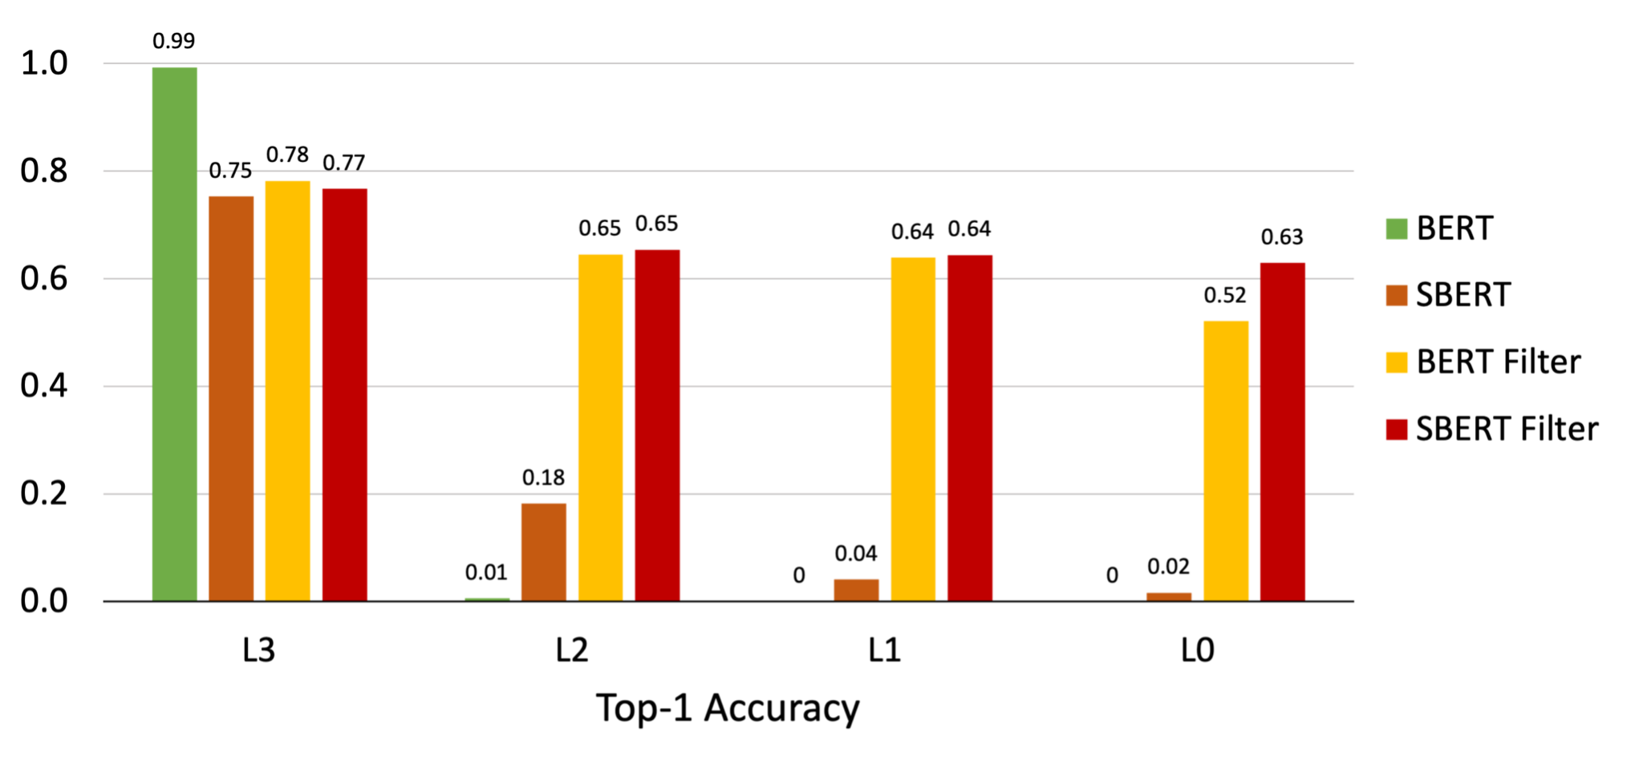
Complexity-Sensitive Retrieval: KAAD Newsela Results
Notes:
However, with our additional filtering mechanism, we can identify even the aligned L0 document as the most relevant 63% of the time when using SBERT. Interestingly, we see that L3 performance does decrease after applying filtering to the initial BERT results. This makes sense, as the filtering model only correctly predicts the complexity of L3 articles 78% of the time. Thus, when we’re attempting to retrieve related documents at a similar complexity level, our filtering mechanism should not be used.

Slide 123
Complexity-Sensitive Retrieval: KAAD Newsela+NYT Results
Notes:
To finish out these experiments, we also show the performance adding in the New York Times distractor articles.

Slide 124
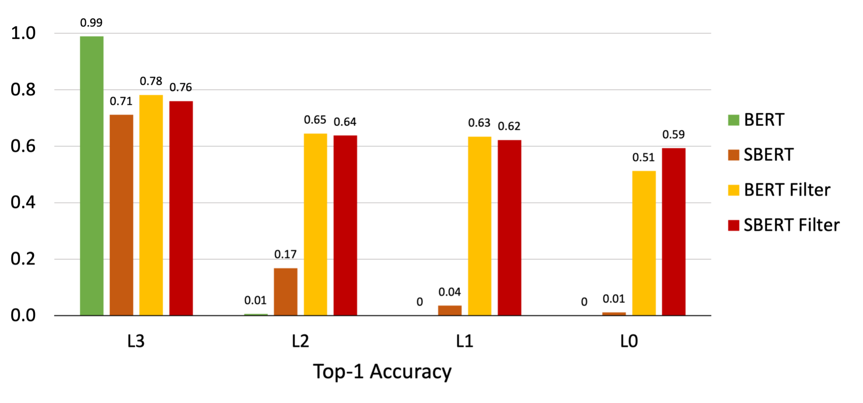
Complexity-Sensitive Retrieval: KAAD Newsela+NYT Results
Notes:
As we can see, from over 1 million documents we are still able to identify the correct L0 document 59% of the time. While there is still room for improvement, these experiments provide a framework for retrieving relevant documents at any complexity level.

Slide 125
Takeaways
Utilizing additional context allows for improvement of lexical simplification systems
Notes:
So, the key takeaways from this presentation are as follows. First, I showed that making use of the context surrounding a word allows for improvement of lexical simplification systems.

Slide 126
Takeaways
Utilizing additional context allows for improvement of lexical simplification systems
Incorporating diverse candidate generation and re-ranking increases performance of neural sentence simplification models
Notes:
Second, we showed that integrating diverse candidate generation and post-inference re-ranking improves performance of neural models for sentence simplification.

Slide 127
Takeaways
Utilizing additional context allows for improvement of lexical simplification systems
Incorporating diverse candidate generation and re-ranking increases performance of neural sentence simplification models
Leveraging pre-trained language models to estimate the quality of sentence simplification outputs improves correlation with human judgments
Notes:
Third, we demonstrated that pre-trained language models can be effectively leveraged to estimate the quality of sentence simplification outputs without the need for a reference simplification.

Slide 128
Takeaways
Utilizing additional context allows for improvement of lexical simplification systems
Incorporating diverse candidate generation and re-ranking increases performance of neural sentence simplification models
Leveraging pre-trained language models to estimate the quality of sentence simplification outputs improves correlation with human judgments
Reformulating text simplification as a retrieval task has the potential to make the problem more practically useful
Notes:
Finally, we discussed the reformulation of text simplification as a retrieval-based task, and showed how this has the potential to make the field of simplification more practically useful.

Slide 129
Relevant Publications
Reno Kriz, Eleni Miltsakaki, Marianna Apidianaki, and Chris Callison-Burch. Simplification using paraphrases and context-based lexical substitution. In NAACL 2018.
Reno Kriz, João Sedoc, Marianna Apidianaki, Carolina Zheng, Gaurav Kumar, Eleni Miltsakaki, and Chris Callison-Burch. Complexity-weighted loss and diverse reranking for sentence simplification. In NAACL 2019.
Daphne Ippolito*, Reno Kriz*, Maria Kustikova, João Sedoc, and Chris Callison-Burch. Comparison of Diverse Decoding Methods from Conditional Language Models. In ACL 2019.
Reno Kriz, Marianna Apidianaki, and Chris Callison-Burch. Simple-QE: Better Automatic Quality Estimation for Text Simplification. arXiv 2020.
Reno Kriz, Eleni Miltsakaki, Jaime Rojas, Rebecca Iglesias-Flores, Megha Mishra, Marianna Apidianaki, and Chris Callison-Burch. Recasting Text Simplification as a Document Retrieval Task. arXiv 2021.
Notes:
Here are the publications that were discussed in this talk and in my thesis.

Slide 130




Thanks to my collaborators!
Notes:
And finally I wanted to take a minute to thank all of my collaborators. Of course first and foremost my co-advisors Chris Callison-Burch and Marianna Apidianaki, they’ve been amazing from the start of my phd to the end. I also could not have made it this far without the help from Eleni Miltsakaki and Joao Sedoc, they not only helped me with several papers but also were available whenever I had questions.

Slide 131






Thanks to my collaborators!
Notes:
Also my other collaborators. On the work in my thesis I received so much help from Daphne Ippolito, Rebecca Iglesias Flores, Jaime Rojas, Carolina Zheng, Gaurav Kumar, Megha Mishra, and Maria Kustikova. There are two many people to thank, but I’d also like to thank Anne Cocos and everyone else in my lab for helping me and giving me so much great feedback over the years.

